Slide 1
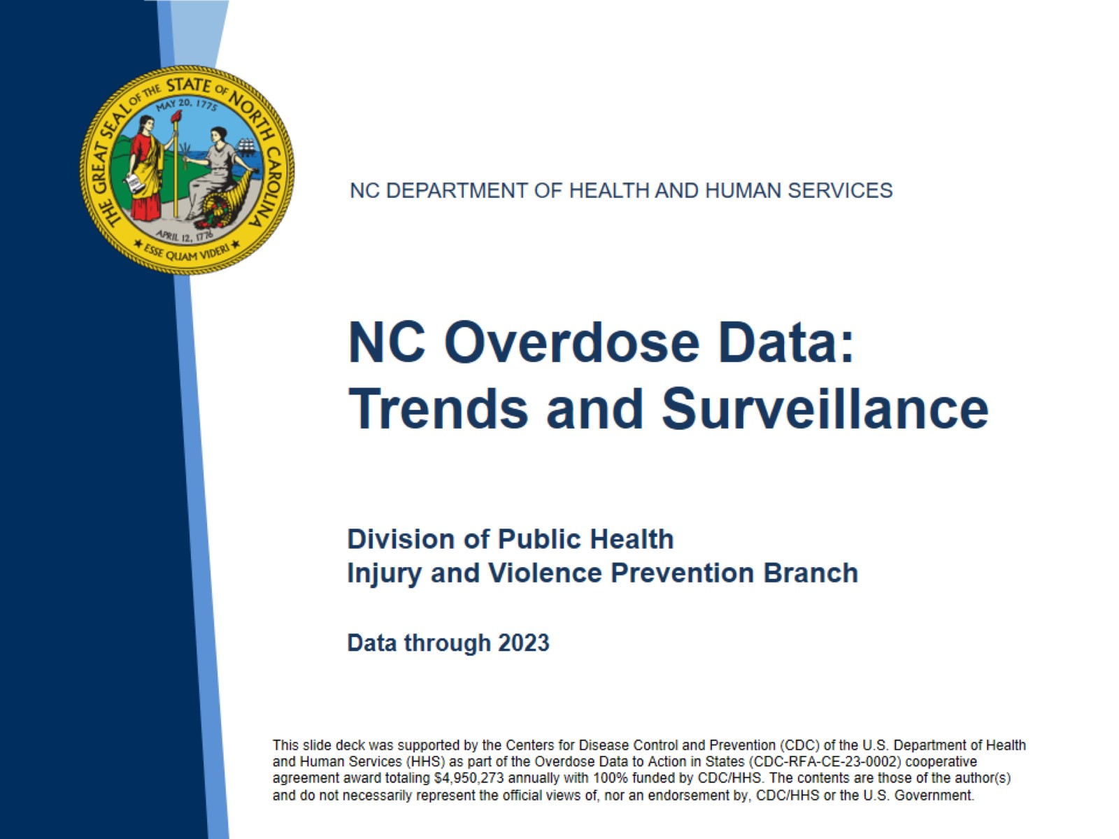
Notes:
This slide set was created to provide basic data trends and public health surveillance around the drug overdose epidemic. They are meant to offer a state-level background on drug overdose. If you’d like a copy of the slides, please visit the Overdose Data page on our branch website, https://www.dph.ncdhhs.gov/programs/chronic-disease-and-injury/injury-and-violence-prevention-branch. The direct link is also shared at the end of this presentation.
Feel free to incorporate these slides into your own presentations, grant proposals, reports, or any other way they may be useful.
Please read both the speaking and technical notes to ensure that data are presented in a consistent manner.

Slide 2
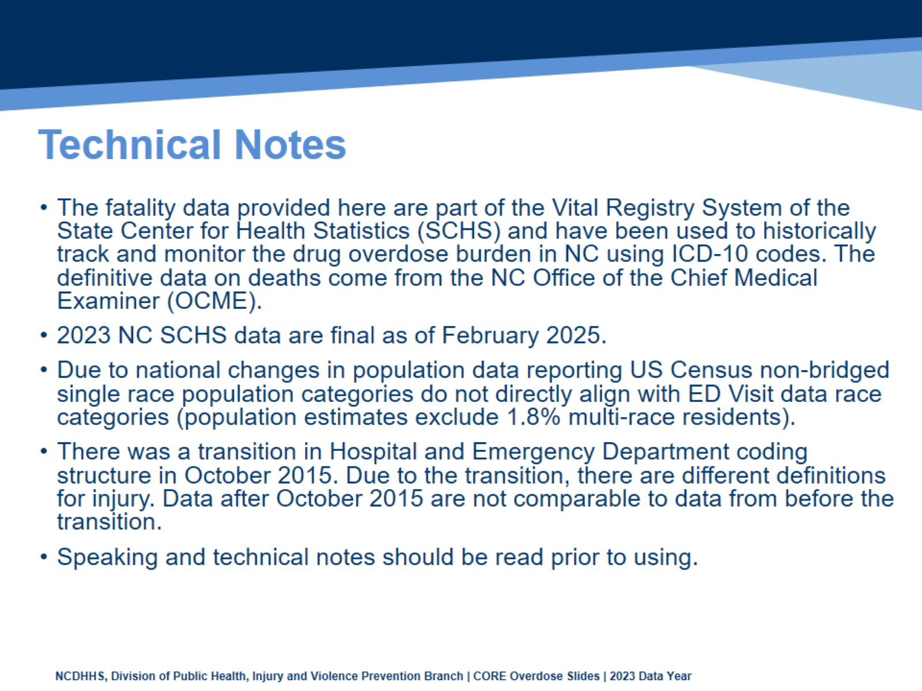
Technical Notes
Notes:
For more detailed technical notes on any of the data shared in this slide set, please contact us at SubstanceUseData@dhhs.nc.gov

Slide 3
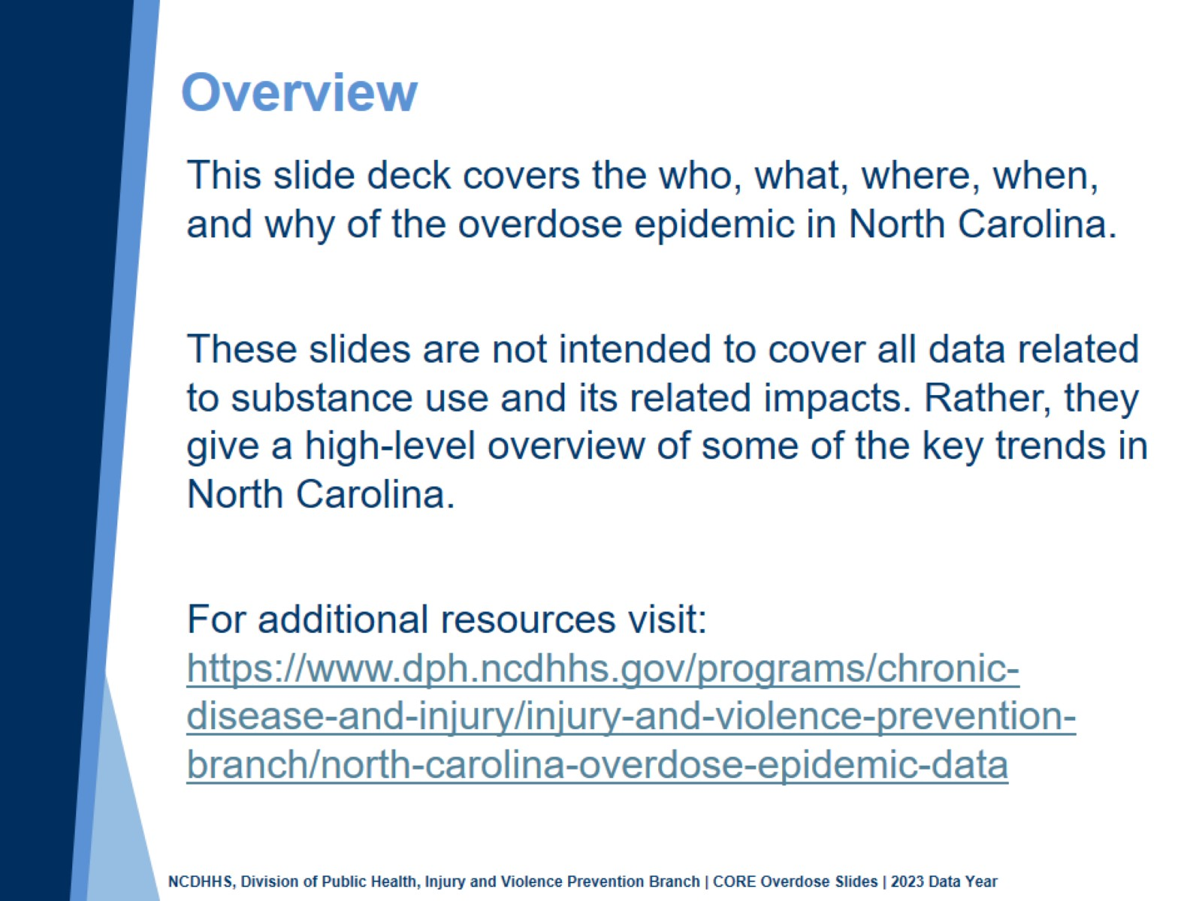
Overview
Notes:
This presentation is not intended to cover all data related to the overdose epidemic. Rather it gives an overview of some of the key trends in North Carolina. It includes information on statewide medication and drug overdoses, opioid-related overdoses, and our state’s response coordination. Please note that when the COVID-19 pandemic began in 2020, there were many implications, including major changes to the numbers and rates within the overdose data in this slide deck.
If this slide deck does not contain the information you need, please see our custom data request policy and contact us at SubstanceUseData@dhhs.nc.gov.

Slide 4
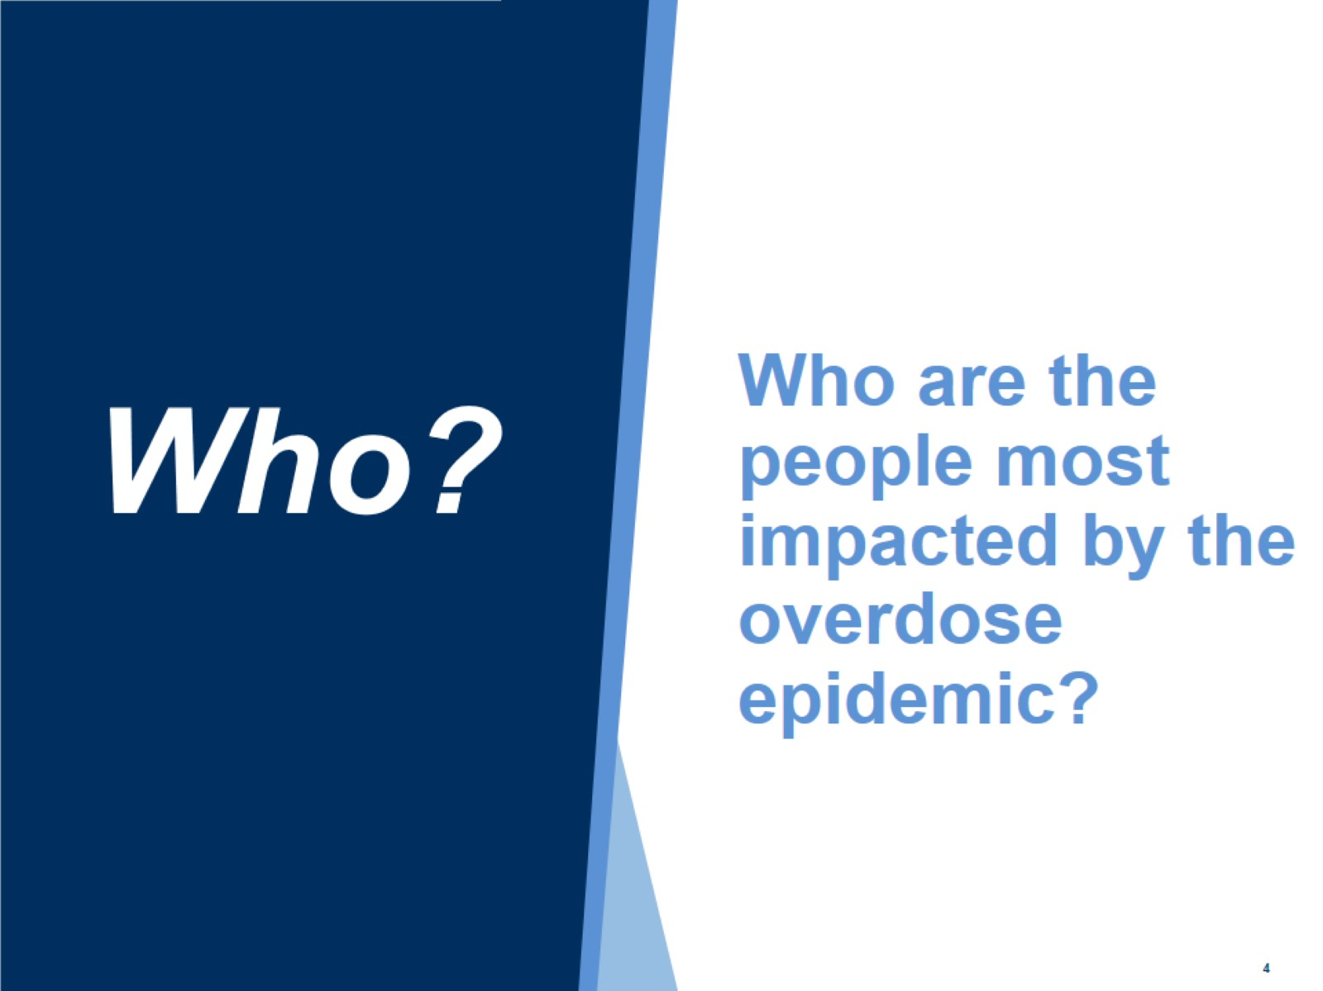
Who are the people most impacted by the overdose epidemic?

Slide 5
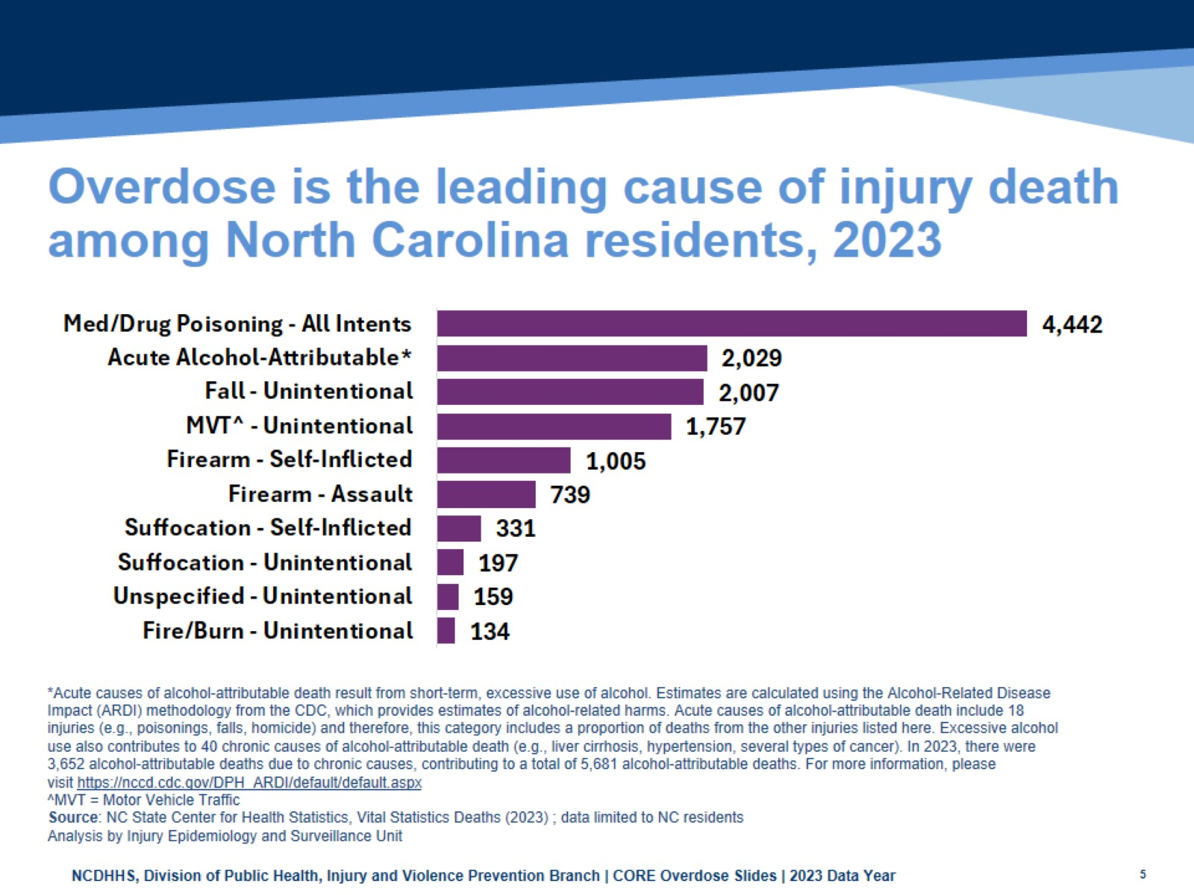
Overdose is the leading cause of injury death among North Carolina residents, 2023
Notes:
In 2023, the leading cause of injury death was all intents medication or drug poisoning (4,442), followed by acute alcohol attributable (2,029; short-term excessive use of alcohol), unintentional falls (2,007) and unintentional motor vehicle traffic-related injury (1,757).

Slide 6
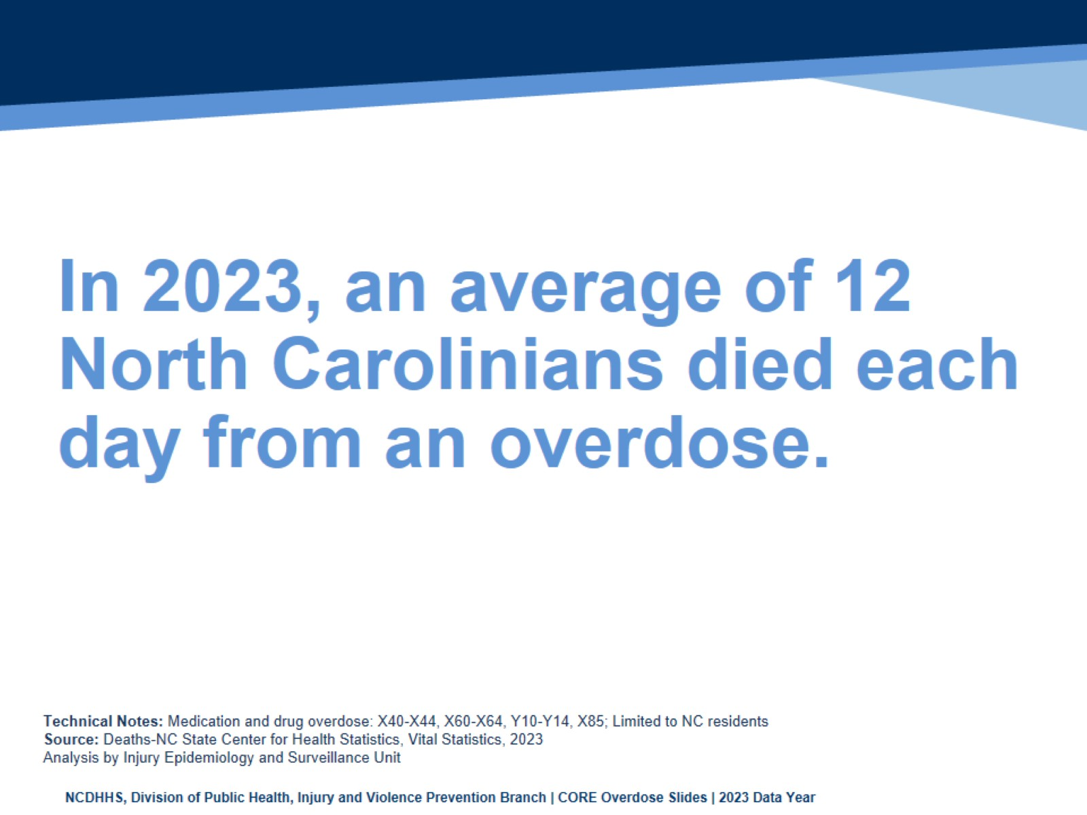
In 2023, an average of 12 North Carolinians died each day from an overdose.
Notes:
In 2023, an average of 12 North Carolinians died each day from an overdose. Though largely driven by fentanyl, this number includes overdose deaths from other medications and drugs (cocaine, benzodiazepines, etc). This number includes all medication and/or drug overdoses, including unintentional, self-inflicted, undetermined, and assault.

Slide 7
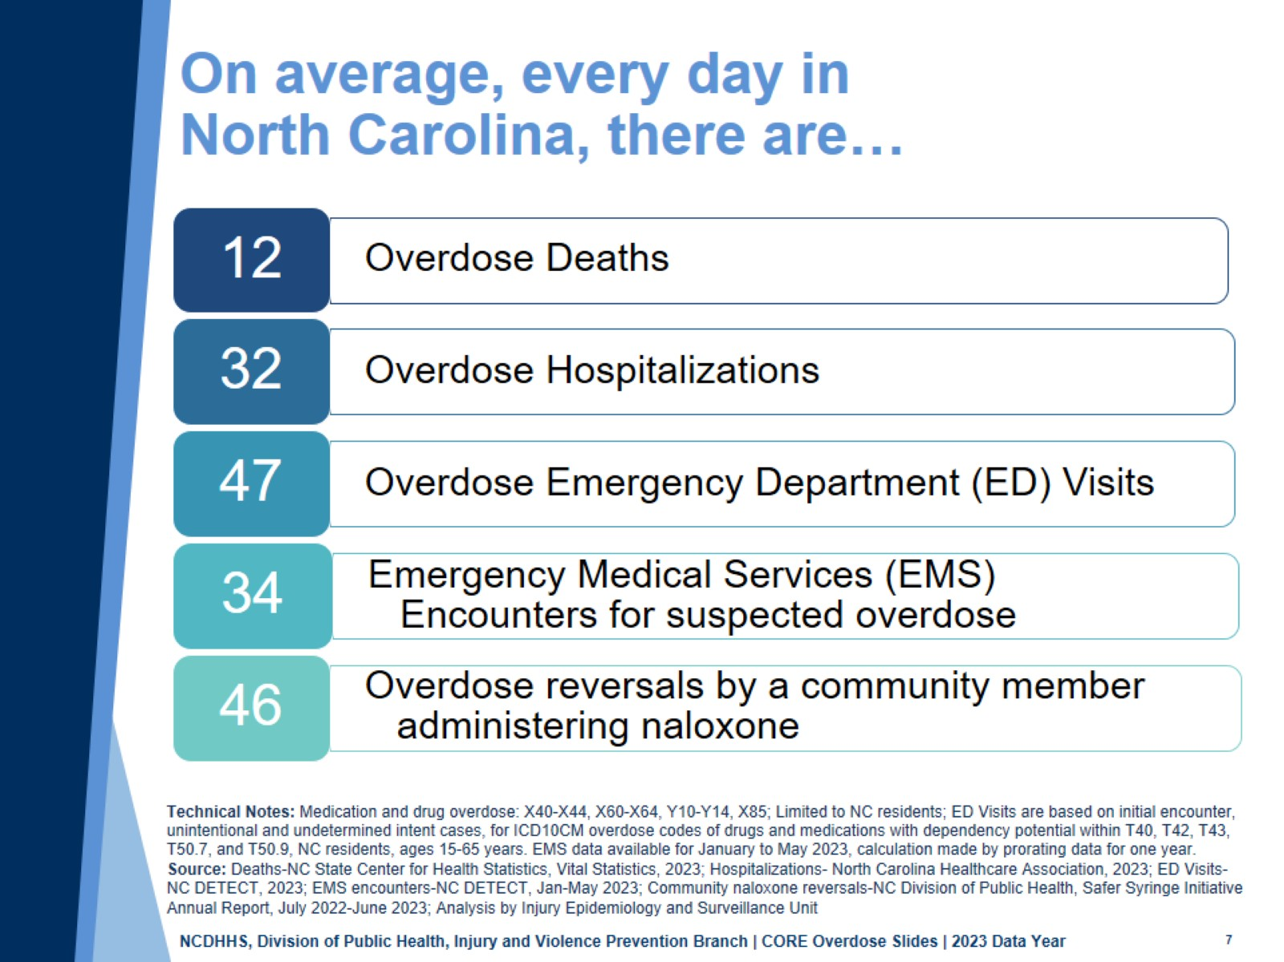
On average, every day in North Carolina, there are…
Notes:
An overdose is an injury with a range of outcomes and impacts.
In North Carolina, there are on average, 12 overdose deaths, 32 overdose hospitalizations, 47 overdose-related emergency department visits, 34 emergency medical services (EMS) encounters for suspected overdoses, and 46 naloxone reversals by community members each day. Addressing this issue requires a collaborative effort between communities, healthcare providers, and public health organizations to reduce the impacts on both individuals and the healthcare system.

Slide 8
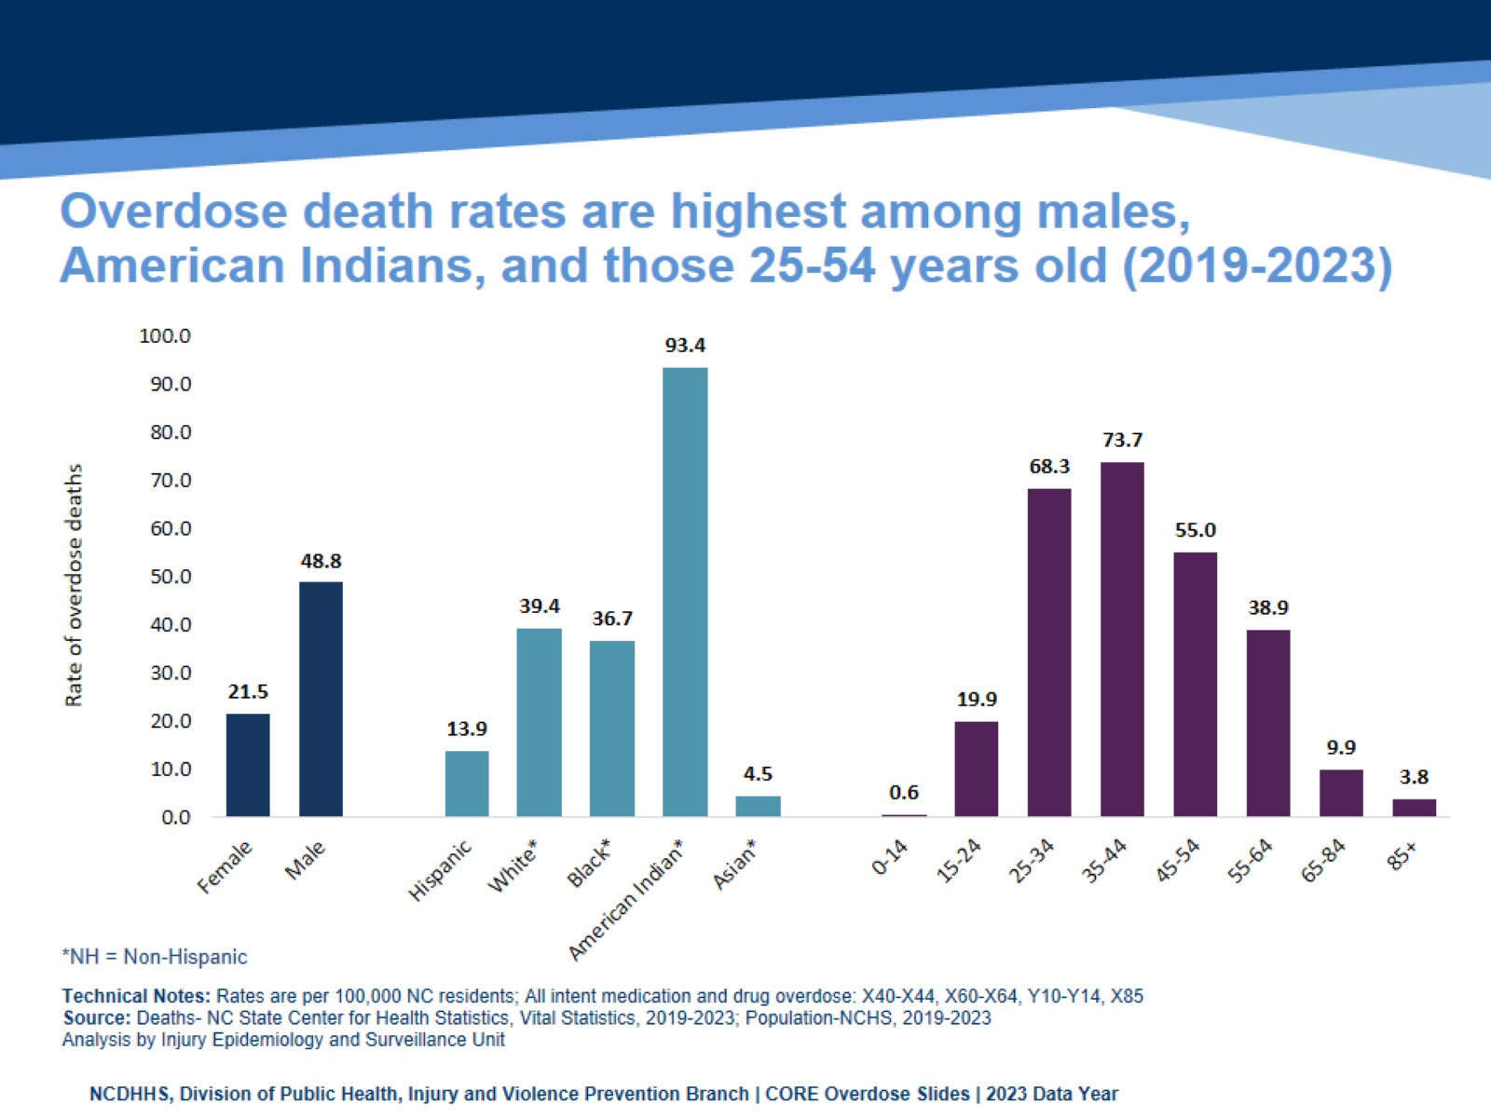
Overdose death rates are highest among males, American Indians, and those 25-54 years old (2019-2023)
Notes:
The highest rates of med/drug overdose deaths occurred among NC residents ages 35-44 (73.7 per 100,000) and 25-34 (68.3 per 100,000), males (48.8 per 100,000), Non-Hispanic American Indians (93.4 per 100,000). These rates are calculated over a five-year time period (2019-2023).

Slide 9
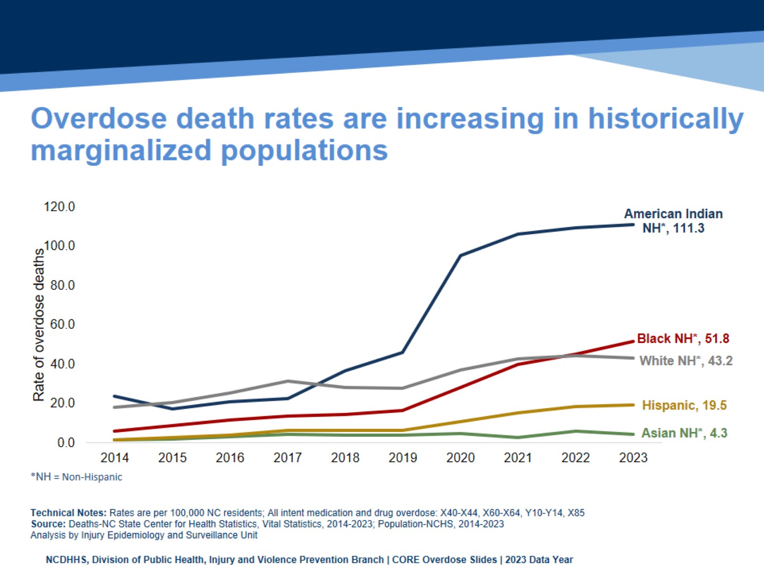
Overdose death rates are increasing in historically marginalized populations
Notes:
The number of people who have died from overdose has also worsened in some historically marginalized communities. The overall number of overdose deaths is still highest among non-Hispanic white people; however, when measured as a portion of population, American Indian/Indigenous people have the highest overdose death rate.
The percentage by which overdose death rates increased from pre-COVID-19 rates in 2019 to 2023 rates was highest for Black/African American people and Hispanic people with their rates increasing 200% or more. Before the COVID-19 pandemic, the overdose death rate for Black residents in North Carolina remained lower than that of white residents. However, since 2020, the rate among Black residents has climbed at a faster pace, and in 2023 the overdose death rate among Black residents surpassed the rate among white residents. American Indian/Indigenous populations also experienced a 141% increase in overdose death rates from 2019 to 2023.

Slide 10
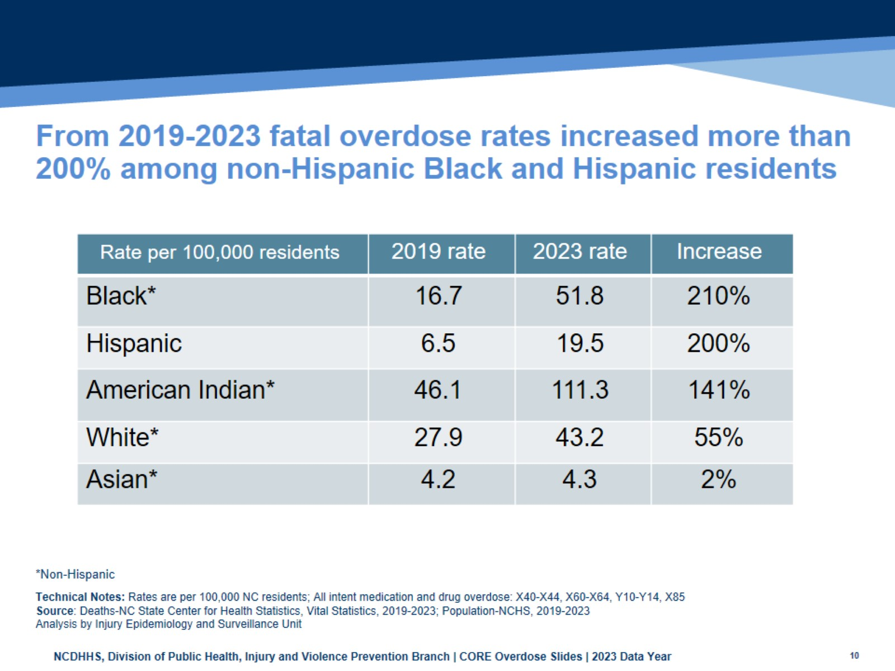
From 2019-2023 fatal overdose rates increased more than 200% among non-Hispanic Black and Hispanic residents
Notes:
This table shows the overdose death rates in North Carolina (per 100,000 residents) by year and race and shows the increase from pre-pandemic (2019) to 2023.
The overall number of overdose deaths is still highest among non-Hispanic white people; however, when measured as a portion of population, American Indian/Indigenous people have the highest overdose death rate. The percentage by which overdose death rates increased from pre-COVID-19 rates in 2019 to 2023 rates was highest for Black/African American people and Hispanic people with their rates increasing 200% or more. Before the COVID-19 pandemic, the overdose death rate for Black residents in North Carolina remained lower than that of white residents. However, since 2020, the rate among Black residents has climbed at a faster pace, and in 2023 the overdose death rate among Black residents surpassed the rate among white residents. American Indian/Indigenous populations also experienced a 141% increase in overdose death rates from 2019 to 2023.

Slide 11
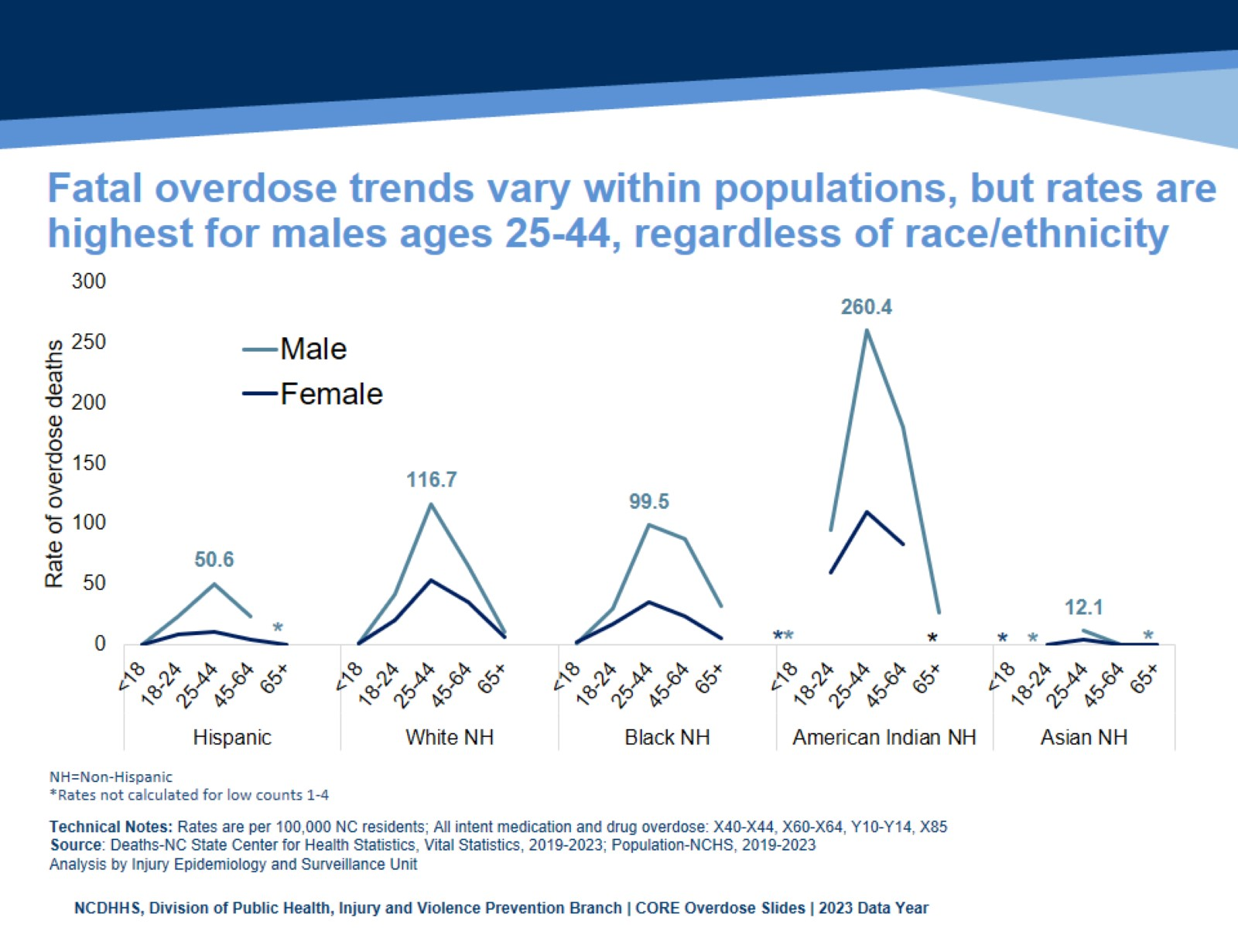
Fatal overdose trends vary within populations, but rates are highest for males ages 25-44, regardless of race/ethnicity
Notes:
Overdose death rate trends vary within populations. This graph shows the breakdown of rates (2019-2023) by race/ethnicity. And, within each race/ethnicity category the overdose death rate by sex and age group.
Ages 25 to 44 have the highest overdose death rate among all race/ethnicity groups for both males and females.
Within each race there are differences between sex of those ages 25 to 44:
Hispanic males (50.6 per 100,000), Hispanic females (11.1 per 100,000)
White males (116.7 per 100,000), White females (53.0 per 100,000)
Black males (99.5 per 100,000), Black females (35.5 per 100,000)
American Indians had the highest rates for both males (260.4 per 100,000) and females (109.7 per 100,000)
Asians had the lowest rates for both males (12.1 per 100,000) and females (4.6 per 100,000)

Slide 12
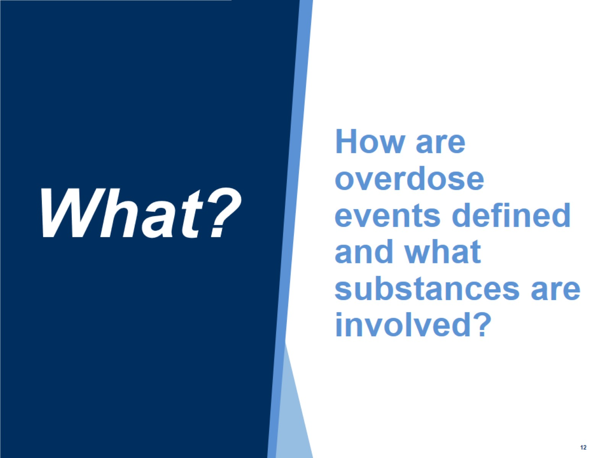
How are overdose events defined and what substances are involved?

Slide 13
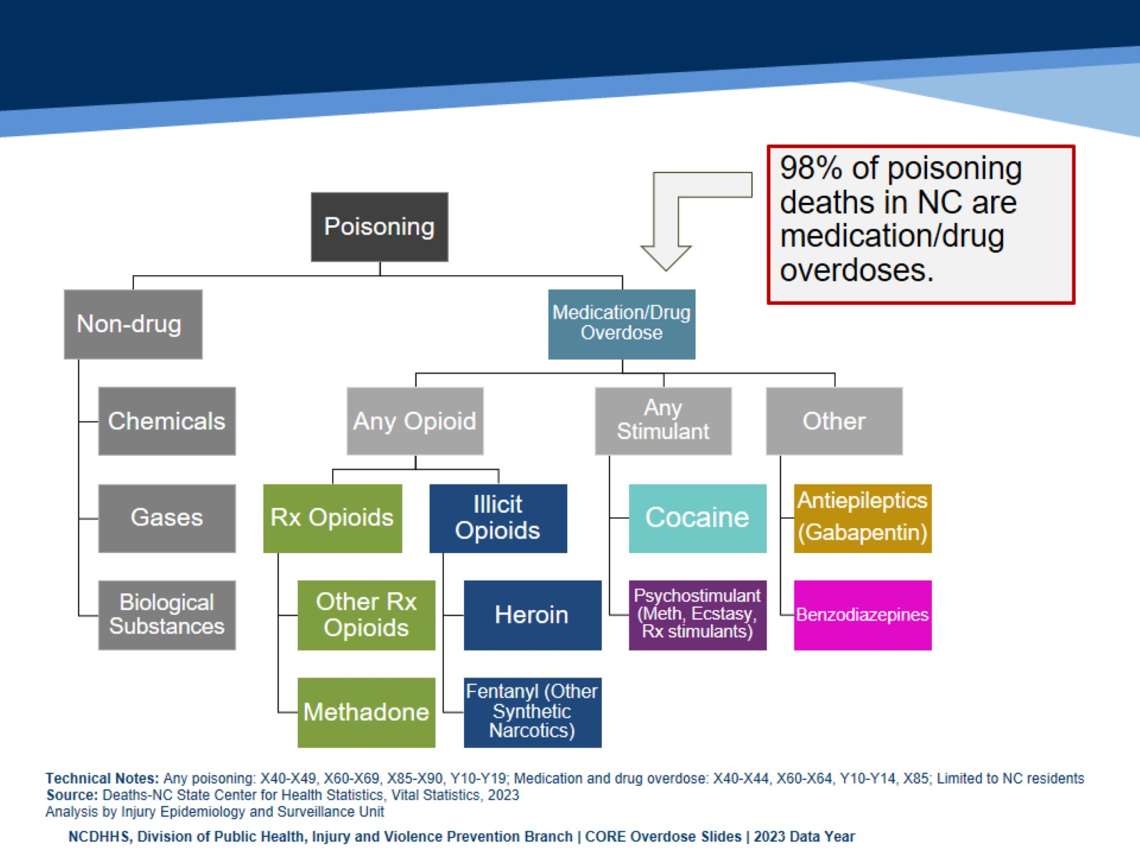
98% of poisoning deaths in NC are medication/drug overdoses.
Notes:
In 2023, there were 4,553 poisoning deaths among North Carolina residents.
Poisonings can involve medications and/or drugs (referred to as an overdose) or be a non-drug poisoning.
4,442 of these were medication and/or drug overdoses. Ultimately, 97.6% of all poisoning deaths were due to medication and/or drug overdose.

Slide 14
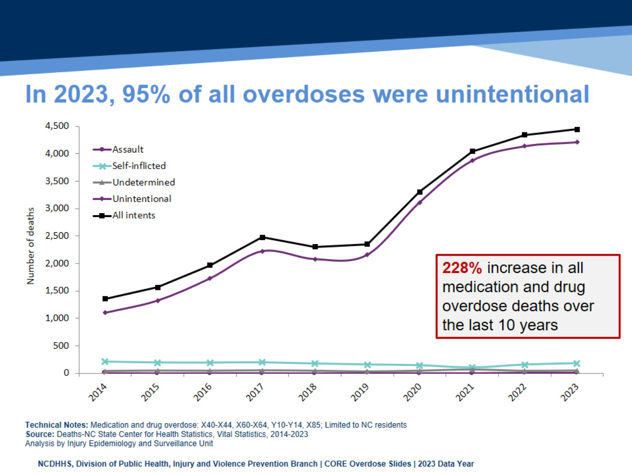
In 2023, 95% of all overdoses were unintentional
Notes:
Overdose deaths can be unintentional, self-inflicted, an assault, or the intent may be undetermined.
In North Carolina, and in the United States as whole, deaths due to an overdose have been steadily increasing since 1999, and in 2023 the vast majority (94.7%) of these are unintentional.
The number of overdose deaths in NC has increased 227.8%, over the last 10 years (2014-2023).

Slide 15
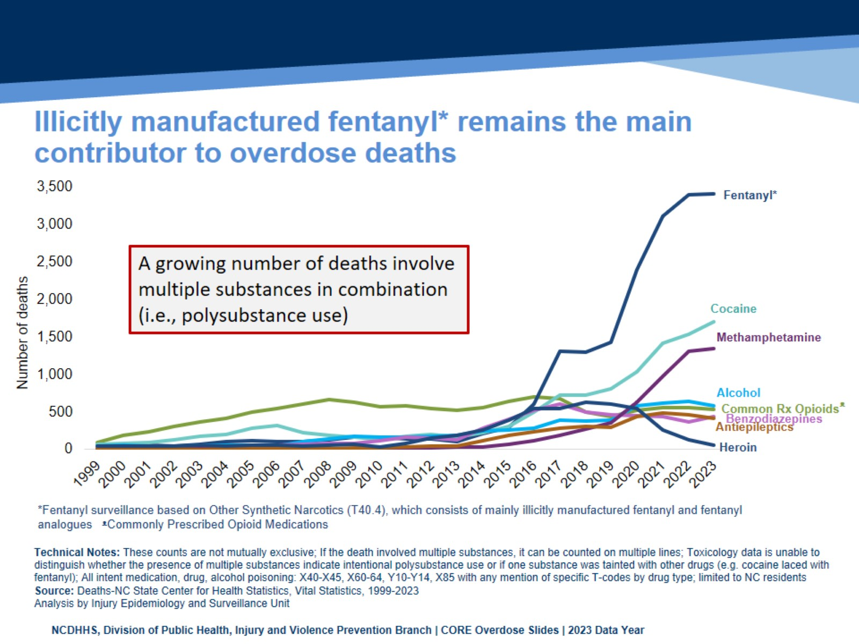
Illicitly manufactured fentanyl* remains the main contributor to overdose deaths
Notes:
The overdose epidemic is mostly driven by fentanyl.
Historically, prescription opioids (drugs like hydrocodone, oxycodone, morphine) contributed to an increasing number of medication/drug overdose deaths. In more recent years, synthetic narcotics such as fentanyl, and fentanyl analogues* have resulted in increased deaths. The number of deaths involving stimulants like cocaine and psychostimulants (which includes methamphetamine) also continue to rise.
These counts are not mutually exclusive. If a death involved multiple substances, it can be counted on multiple lines. A growing number deaths involve multiple substances in combination. Toxicology data is unable to distinguish whether the presence of multiple substances indicate intentional polysubstance use or if one substance was tainted with other drugs (e.g. cocaine laced with fentanyl).
*Fentanyl analogues are drugs that are similar to fentanyl but have been chemically modified in order to bypass current drug laws.

Slide 16
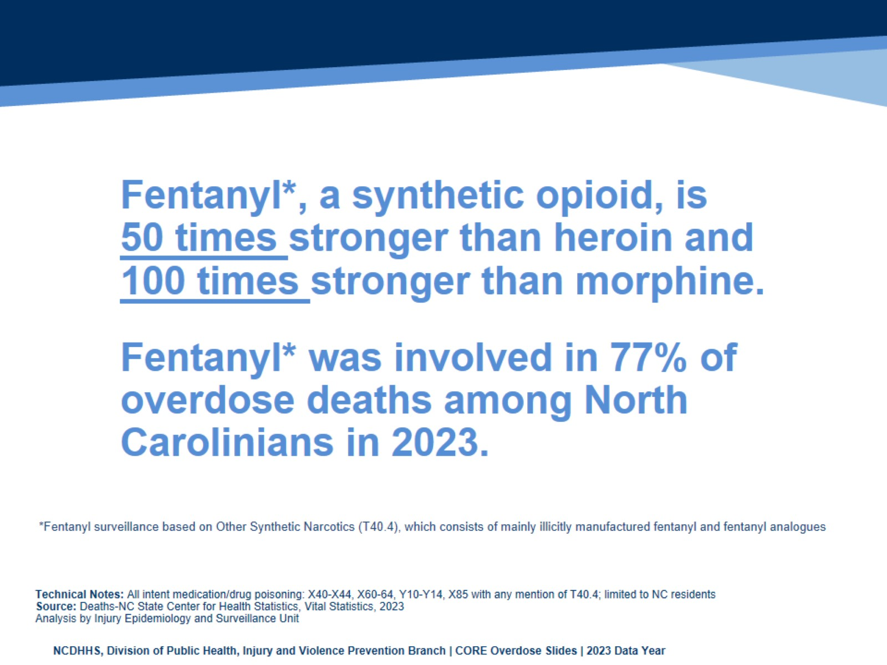

Slide 17
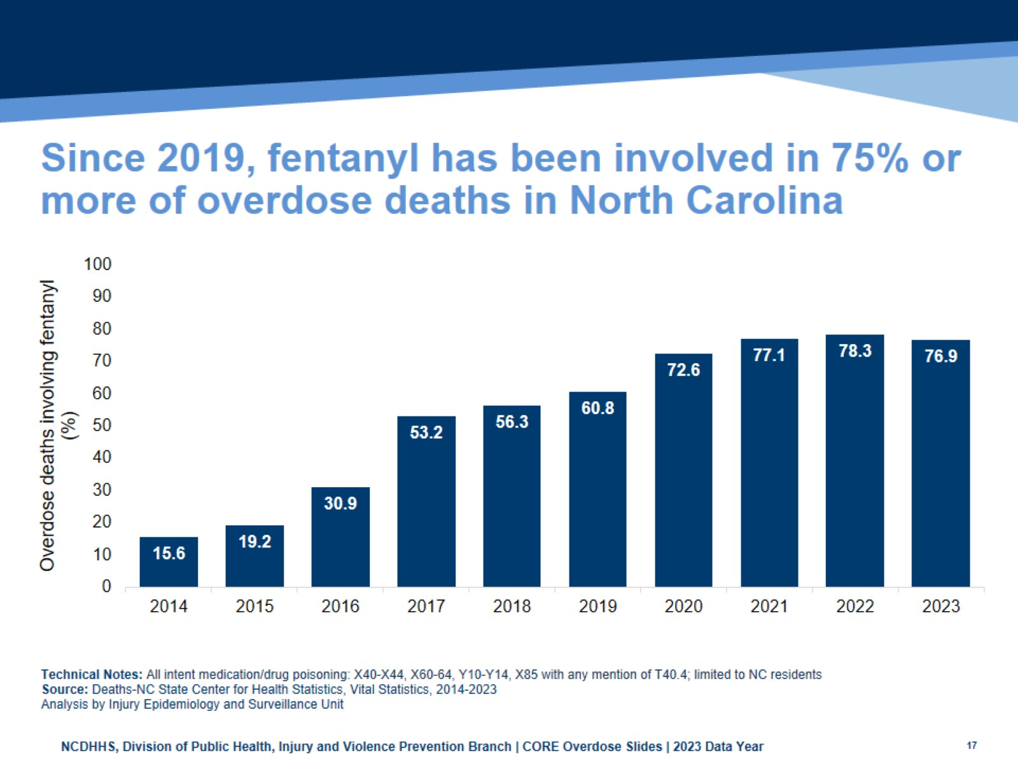
Since 2019, fentanyl has been involved in 75% or more of overdose deaths in North Carolina
Notes:
This graph depicts the increase in the percentage of overdose deaths among North Carolina that involved fentanyl.
Fentanyl involved overdose deaths have increased from 1,429 deaths in 2019 (60.8%) to 3,417 deaths in 2023 (76.9%).
Note:
*There is no individual code for fentanyl involvement on a death certificate; instead, the code T40.4 - an overdose involving another synthetic narcotic is used as a proxy for fentanyl-involvement.
Fentanyl gets coded using the other synthetic narcotic code, but there may be other drugs included in this category; however, we know from toxicology data that the majority of deaths receiving this code involved fentanyl.

Slide 18
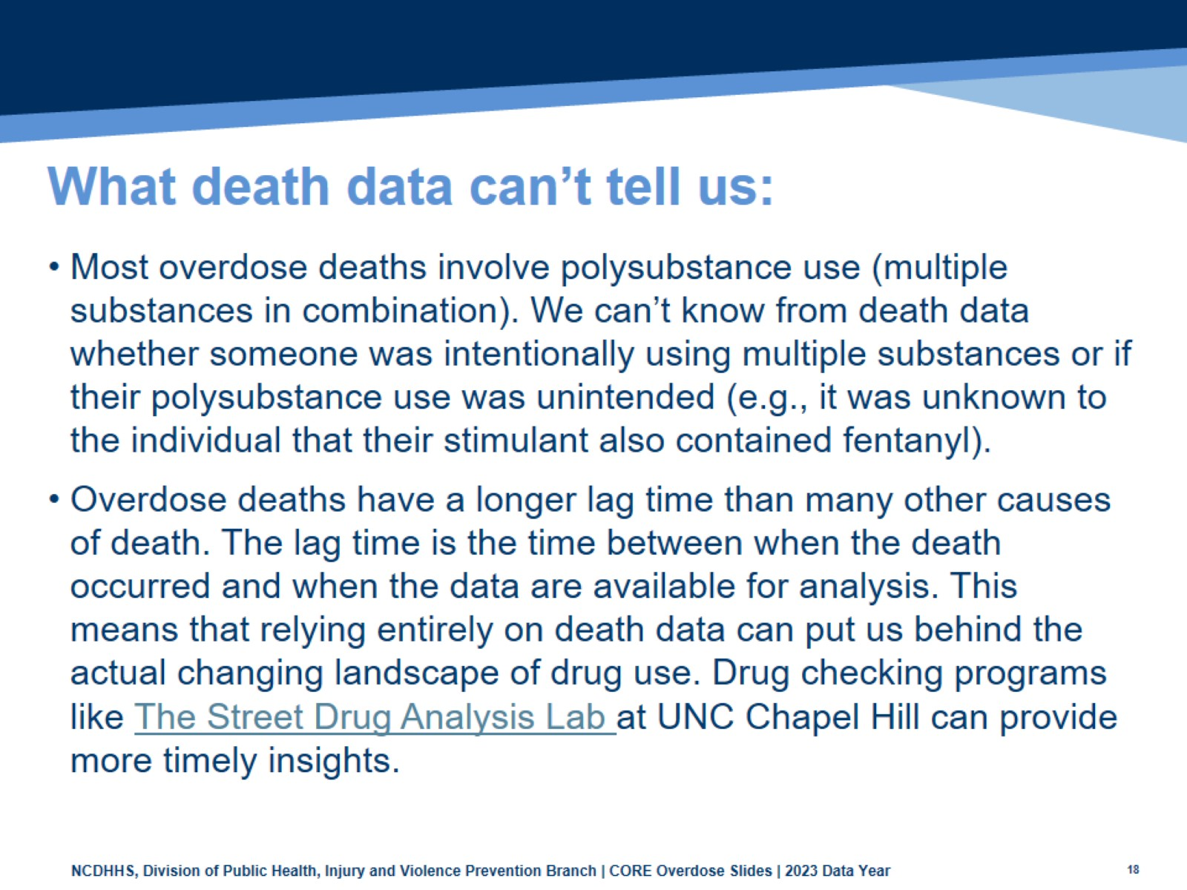
What death data can’t tell us:

Slide 19
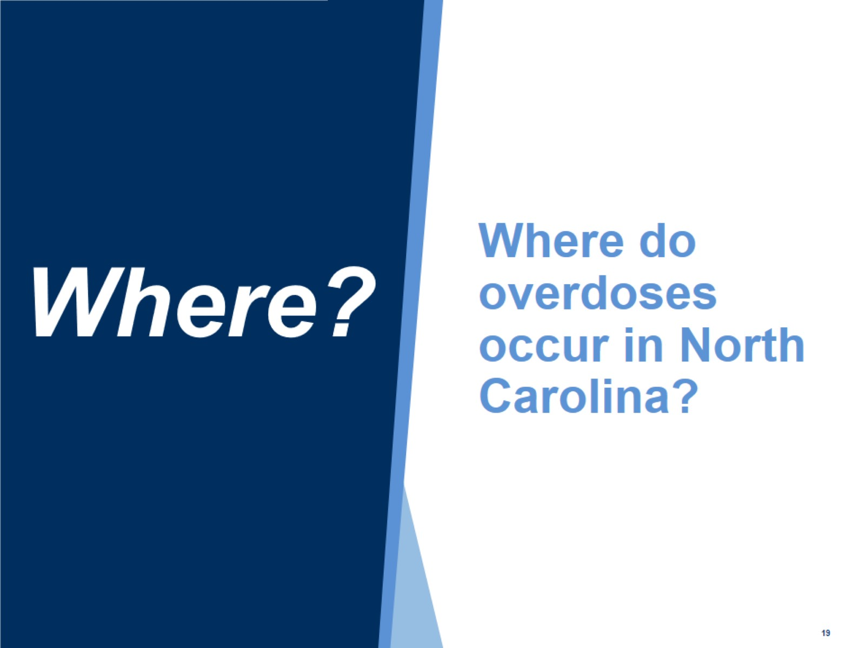
Where do overdoses occur in North Carolina?

Slide 20
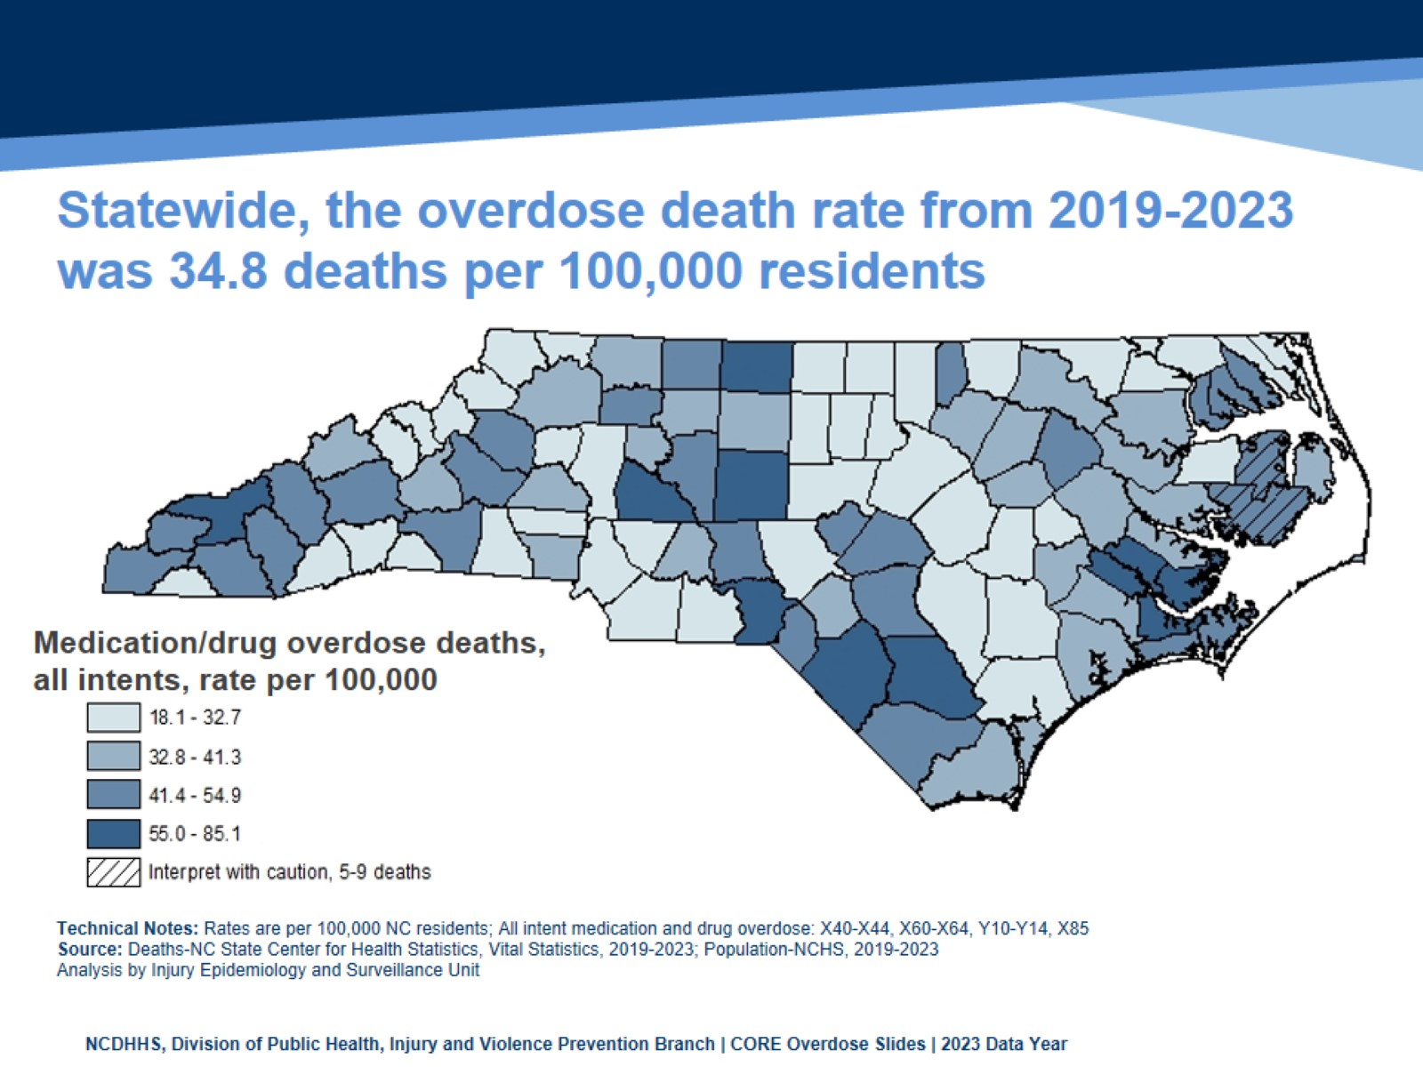
Statewide, the overdose death rate from 2019-2023 was 34.8 deaths per 100,000 residents
Notes:
This map shades the counties of NC based on their respective overdose death rate. The statewide rate was 34.8 per 100,000 residents from 2019-2023. This five-year period was used in order to provide greater reliability in county-level rate estimates.
All counties had more than four deaths, so all rates were calculated. Interpret rates with caution in counties with fewer than 10 deaths.

Slide 21
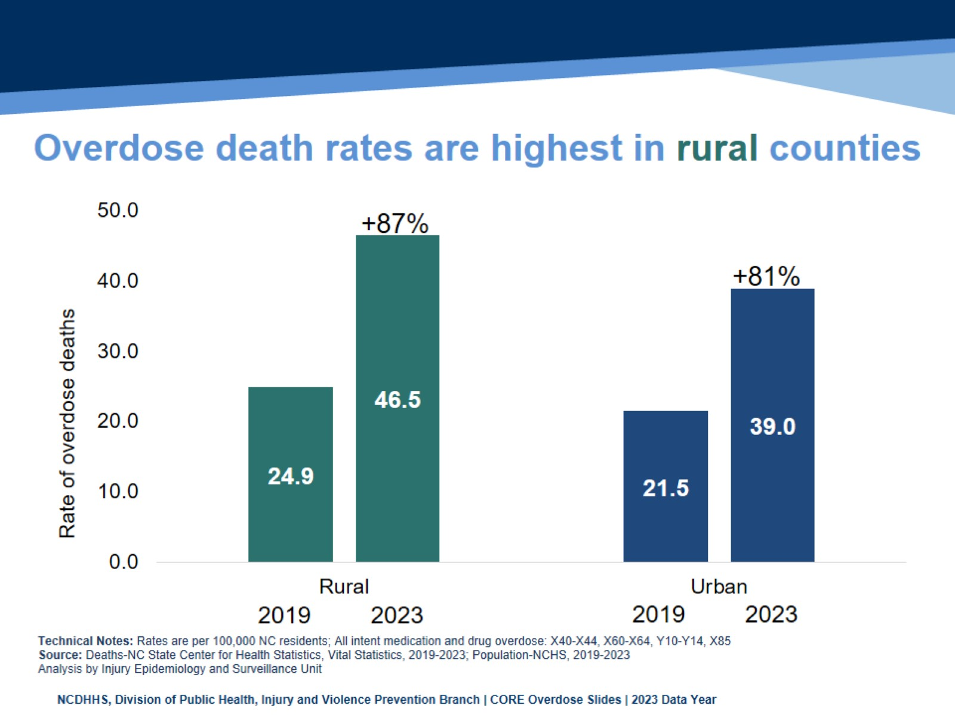
Overdose death rates are highest in rural counties
Notes:
Overdose death rates are highest in rural counties.
Rural counties experienced an 87% rate increase from 2019 (24.9 per 100,000) to 2023 (46.5 per 100,000).
Urban counties experienced an 81% rate increase from 2019 (21.5 per 100,000) to 2023 (39.0 per 100,000).

Slide 22
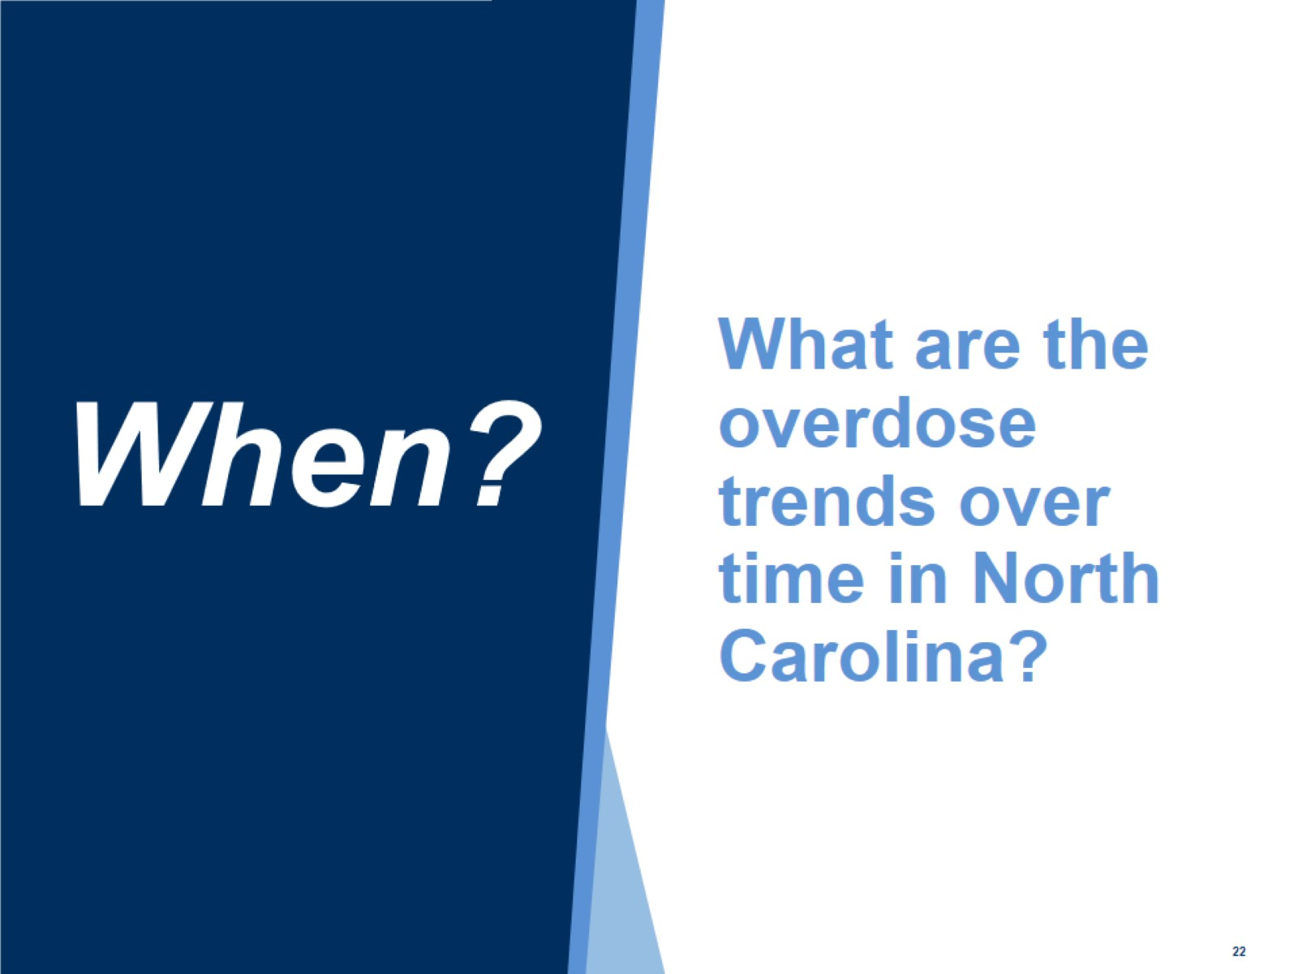
What are the overdose trends over time in North Carolina?

Slide 23
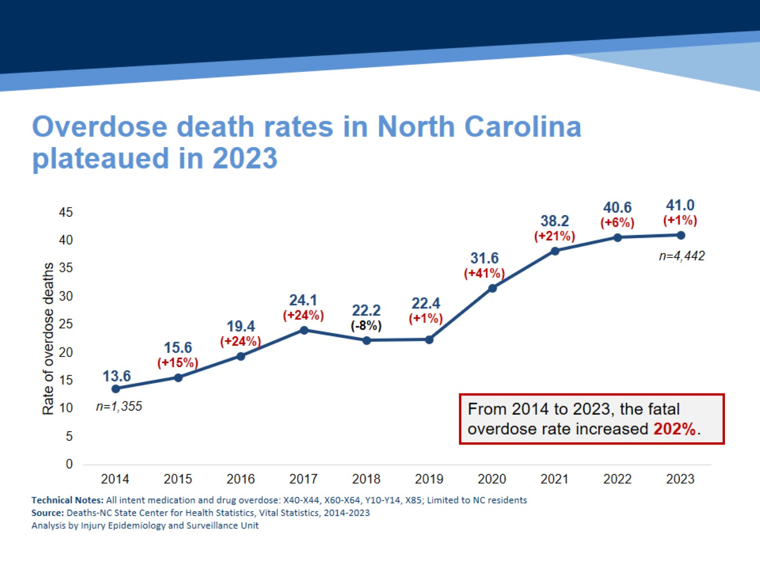
Overdose death rates in North Carolina plateaued in 2023
Notes:
Disruption to public health, healthcare, and social services from COVID-19 all contributed to the 41% increase in 2020 and the continued increases in our state.
This slide looks at the rate of med/drug overdose deaths among NC residents. From 2022, with a death rate of 40.6 per 100,000, to 2023, with a death rate of 41.0 per 100,000, North Carolina saw a 1% increase in the rate of overdose deaths.
The number of overdose deaths increased from 1,355 in 2014 to 4,442 in 2023, a 227.8% increase. Similarly, the rate of overdose deaths increased from 13.6 in 2014 to 41.0 in 2023, a 201.5% increase.

Slide 24
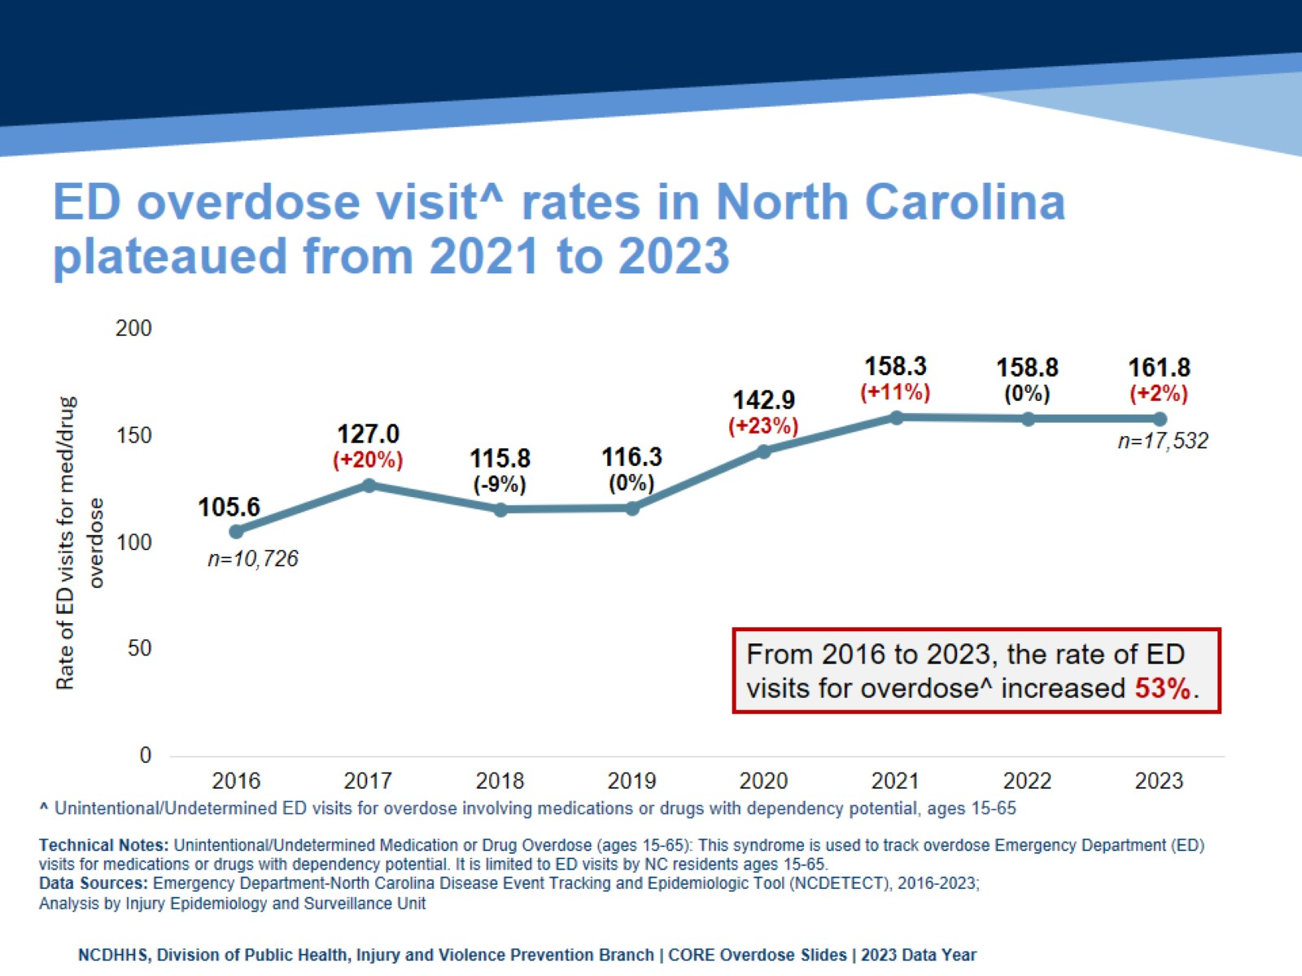
ED overdose visit^ rates in North Carolina plateaued from 2021 to 2023
Notes:
ED visits for overdoses involving medications/drugs with dependency potential plateaued from 2021 to 2023, meaning that the rate has remained relatively stable. In 2022 there were 158.3 ED visits per 100,000 population and in 2023 there were 158.5 ED visits per 100,000 population, a 0.1% increase.
The number of overdose ED visits increased from 13,054 in 2017 to 17,171 in 2023, a 31.5% increase. Similarly, the rate of overdose ED visits increased from 127.1 in 2017 to 158.5 in 2023, a 24.7% increase.
This slide shows rates of unintentional and undetermined overdoses with the potential for misuse among those ages 15 to 65 visits to the Emergency Department. See details of the case definition at https://ncdetect.org/case-definitions/
***NC DETECT is a statewide public health syndromic surveillance system, funded by the NC Division of Public Health (NC DPH) Federal Public Health Emergency Preparedness Grant and managed through collaboration between NC DPH and the UNC-CH Department of Emergency Medicine’s Carolina Center for Health Informatics. The NC DETECT Data Oversight Committee is not responsible for the scientific validity or accuracy of methodology, results, statistical analyses, or conclusions presented.

Slide 25
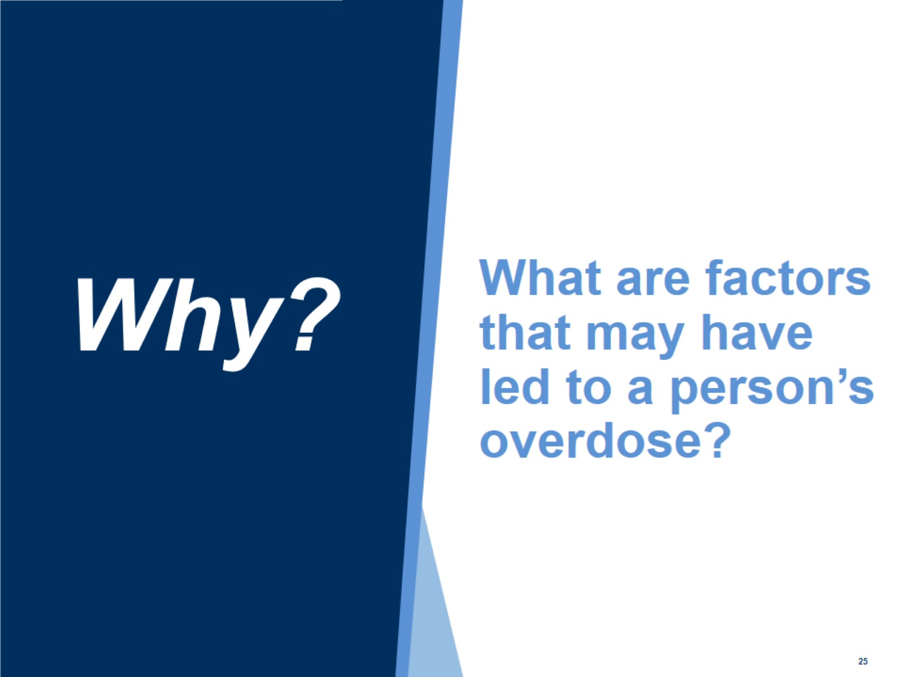
What are factors that may have led to a person’s overdose?

Slide 26
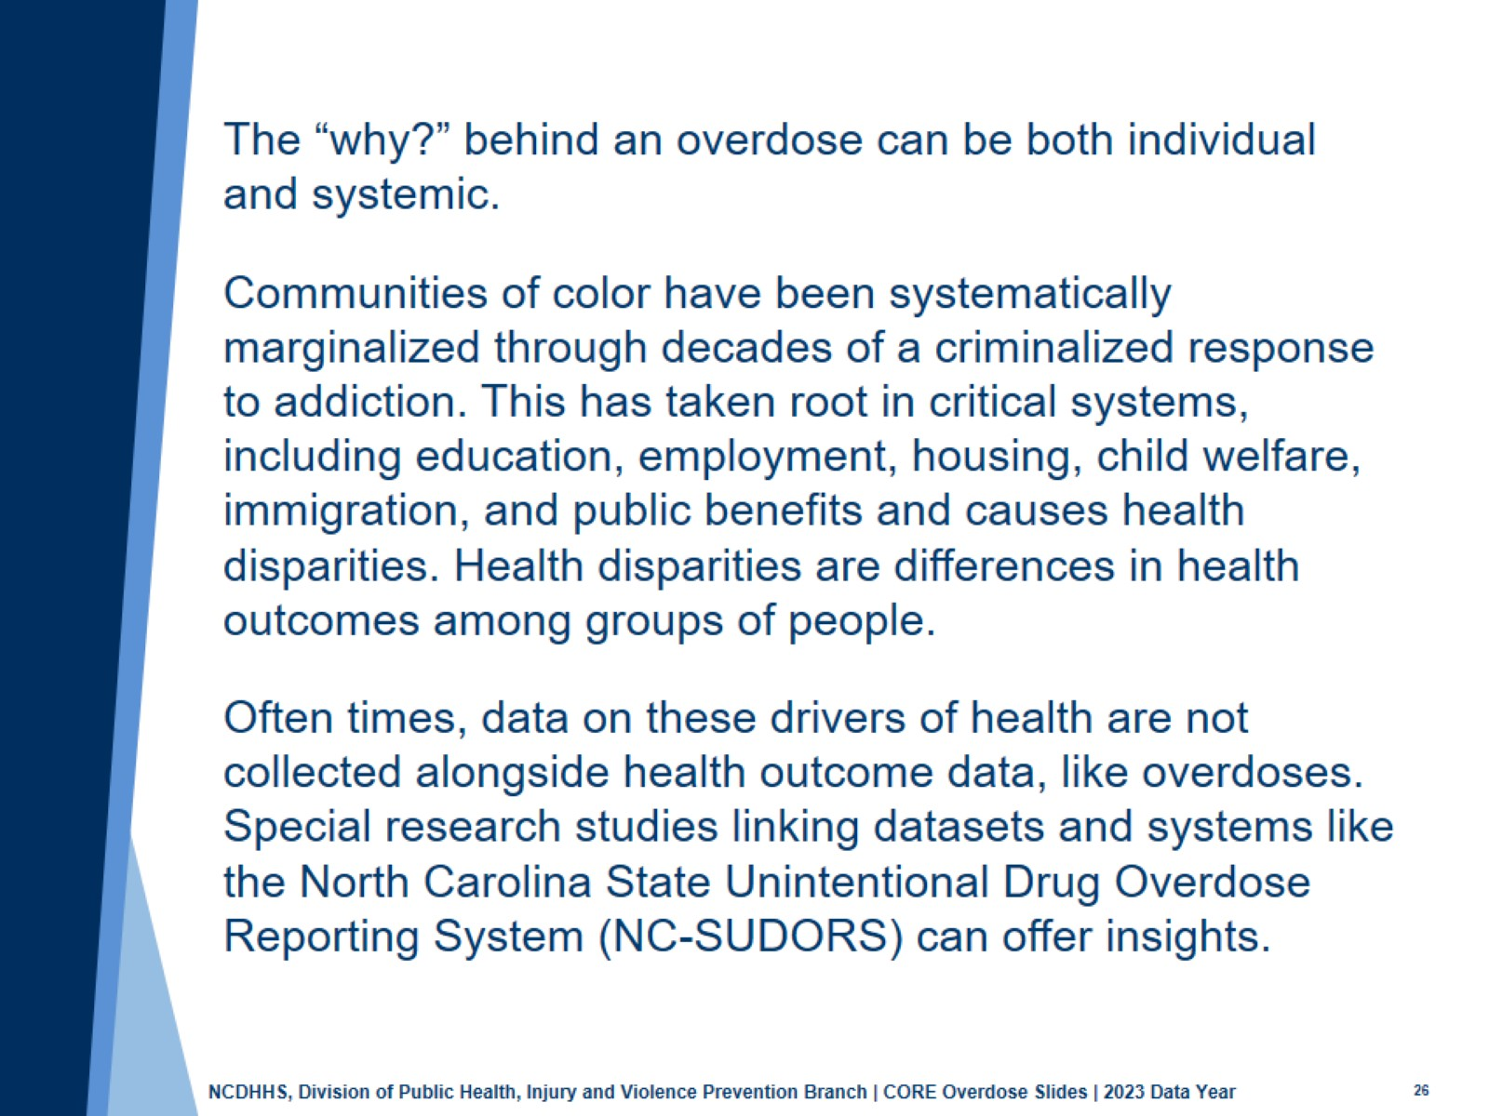

Slide 27
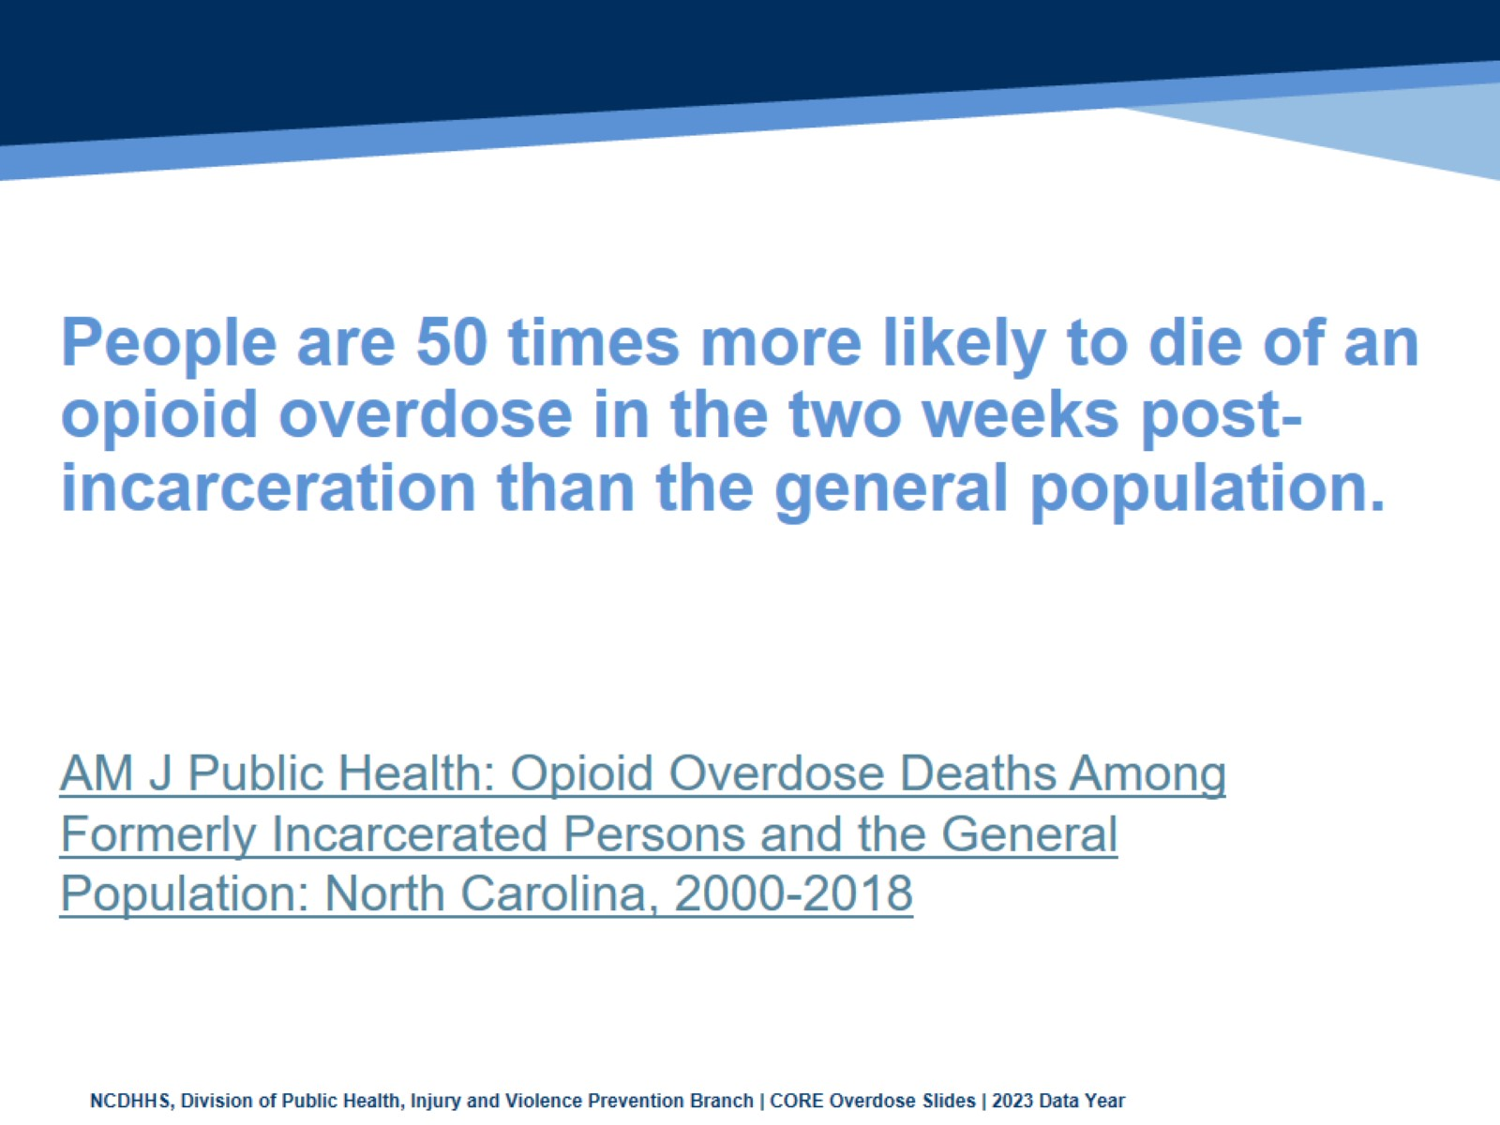
People are 50 times more likely to die of an opioid overdose in the two weeks post-incarceration than the general population.

Slide 28
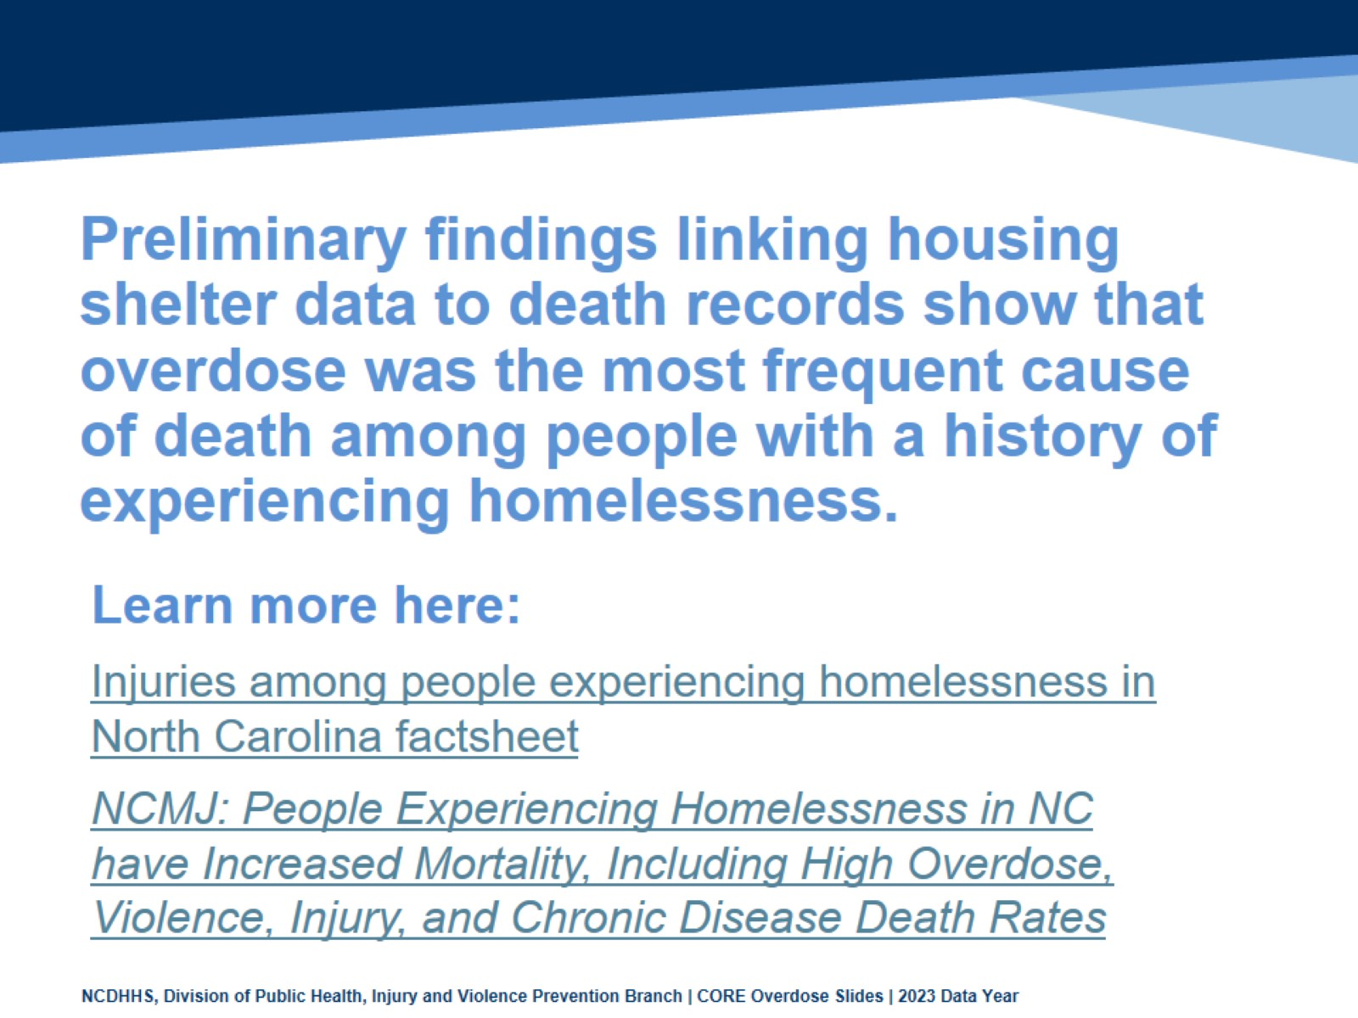
Preliminary findings linking housing shelter data to death records show that overdose was the most frequent cause of death among people with a history of experiencing homelessness.

Slide 29
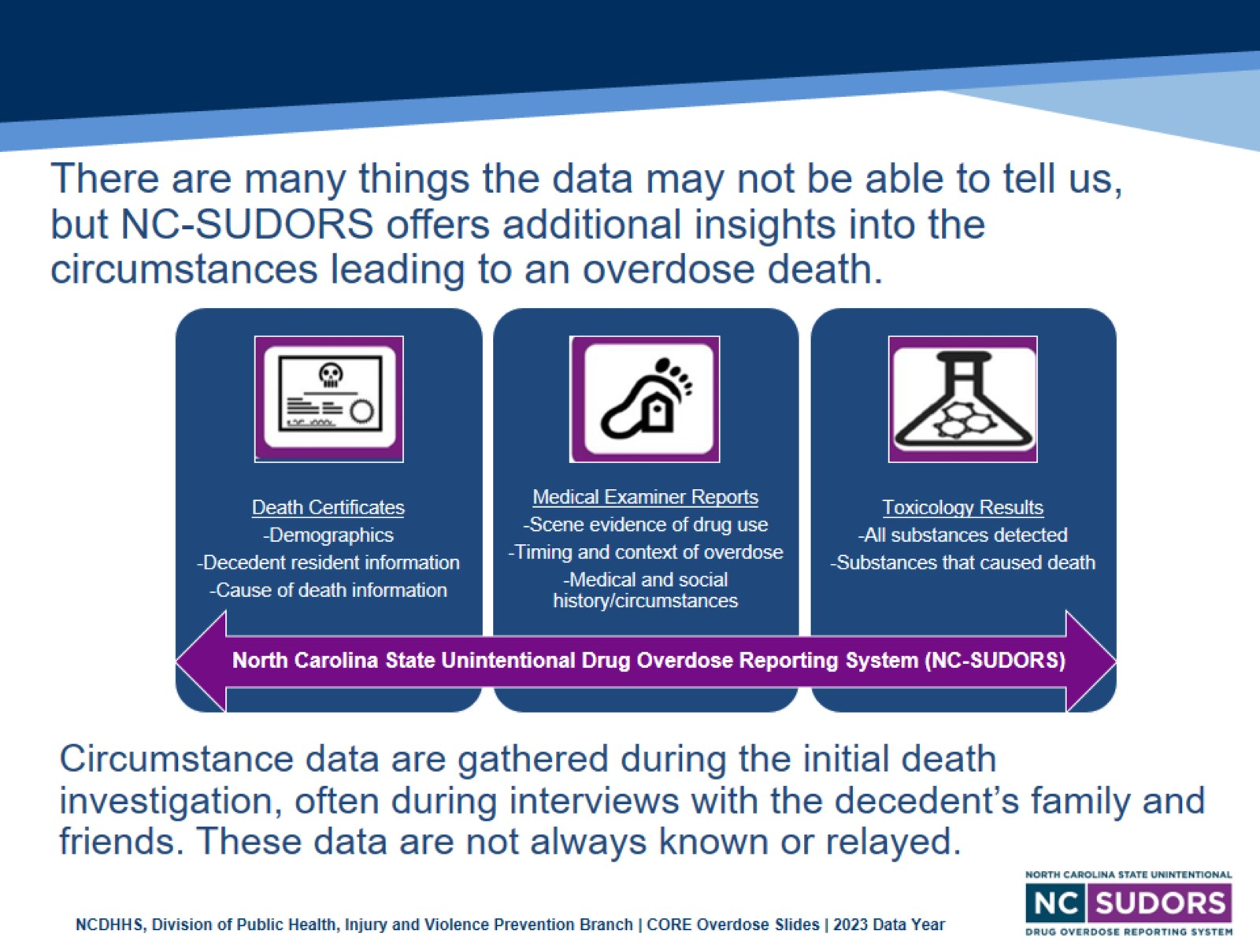
There are many things the data may not be able to tell us, but NC-SUDORS offers additional insights into the circumstances leading to an overdose death.
Notes:
The North Carolina State Unintentional Drug Overdose Reporting System (NC-SUDORS) is made up of multiple sources of data including death certificates, medical examiner/coroner reports, and toxicology results. The incorporation of different sources of data provide a unique opportunity to analyze circumstance data for these unintentional or undetermined overdose deaths.
SUDORS, a program developed by the Centers for Disease Control and Prevention (CDC) enables states to collect detailed overdose death information. SUDORS provides rich circumstance data and highlights opportunities where intervention could save lives. Circumstance data is gathered during the initial death investigation oftentimes during interviews with the decedent’s family and friends. All circumstance data are not always known or relayed during the investigation.

Slide 30
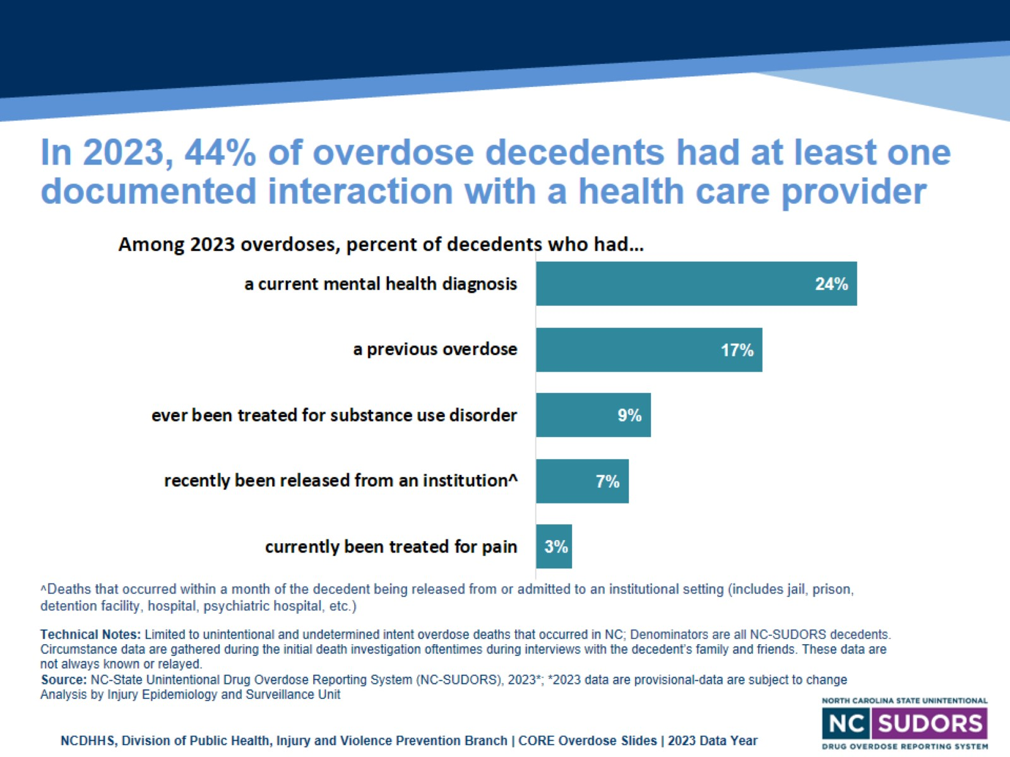
In 2023, 44% of overdose decedents had at least one documented interaction with a health care provider
Notes:
In 2023 43.6% of unintentional or undetermined intent overdose deaths that occurred in North Carolina had at least one document interaction with a health care provider.
Opportunities for intervention exist every time a patient interacts with a medical provider in the healthcare system.
These data come from the State Unintentional Drug Overdose Reporting System (SUDORS), a program developed by the Centers for Disease Control and Prevention (CDC) as a response to the opioid overdose epidemic to enable states to collect detailed overdose death information. SUDORS provides rich circumstance data and highlights opportunities where intervention could save lives. Circumstance data is gathered during the initial death investigation oftentimes during interviews with the decedent’s family and friends. All circumstance data are not always known or relayed during the investigation. Stigma associated with mental health conditions contributes to underreporting of MH burden among this population-counts are likely higher than reported.

Slide 31
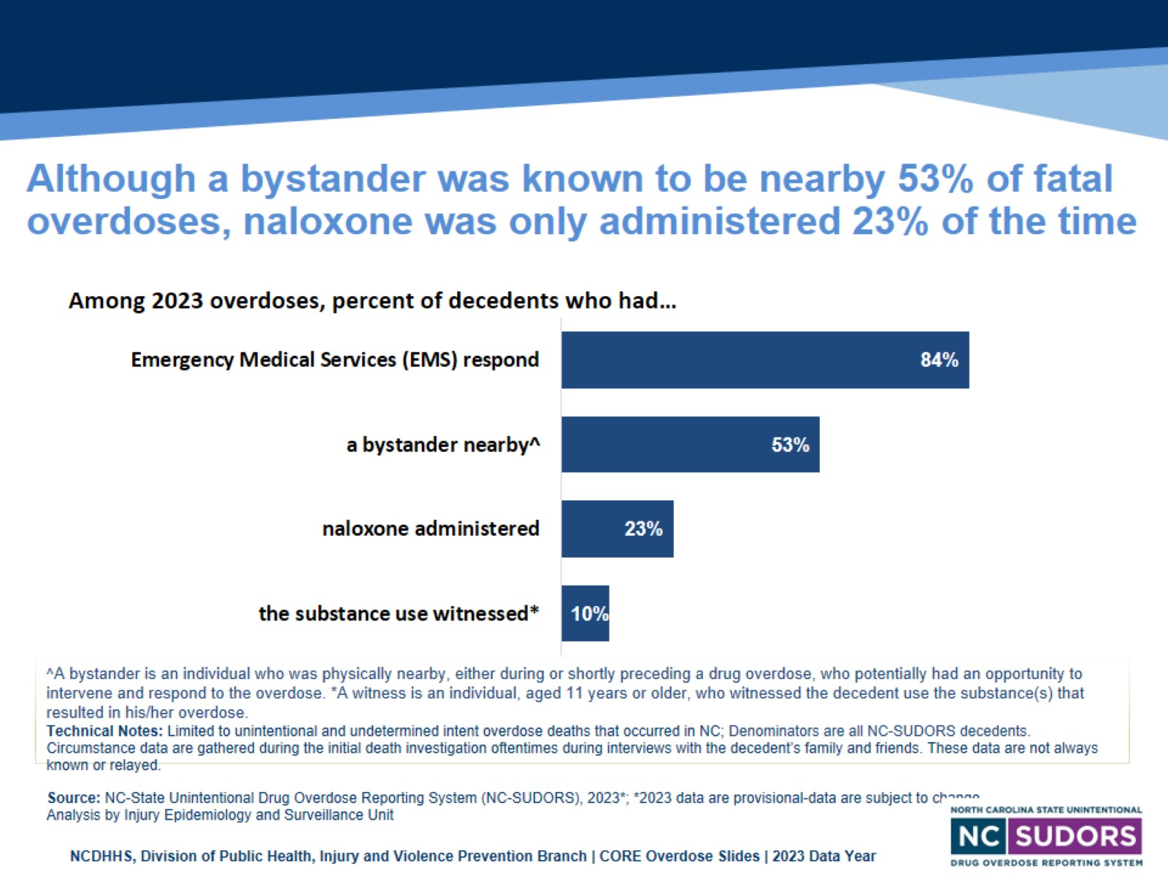
Although a bystander was known to be nearby 53% of fatal overdoses, naloxone was only administered 23% of the time
Notes:
The response of bystanders and/or EMS personnel are important factors that can be used to inform and guide overdose prevention efforts in North Carolina. Naloxone should be provided to any individual at risk for overdose, their family and friends with directions for use. In 2023, at least one bystander was known to be present at 53.1% of fatal overdoses, naloxone was only administered 23% of the time.
These data come from the State Unintentional Drug Overdose Reporting System (SUDORS), a program developed by the Centers for Disease Control and Prevention (CDC) as a response to the opioid overdose epidemic to enable states to collect detailed overdose death information. SUDORS provides rich circumstance data and highlights opportunities where intervention could save lives. Circumstance data is gathered during the initial death investigation oftentimes during interviews with the decedent’s family and friends. All circumstance data are not always known or relayed during the investigation. Stigma associated with mental health conditions contributes to underreporting of MH burden among this population-counts are likely higher than reported.

Slide 32
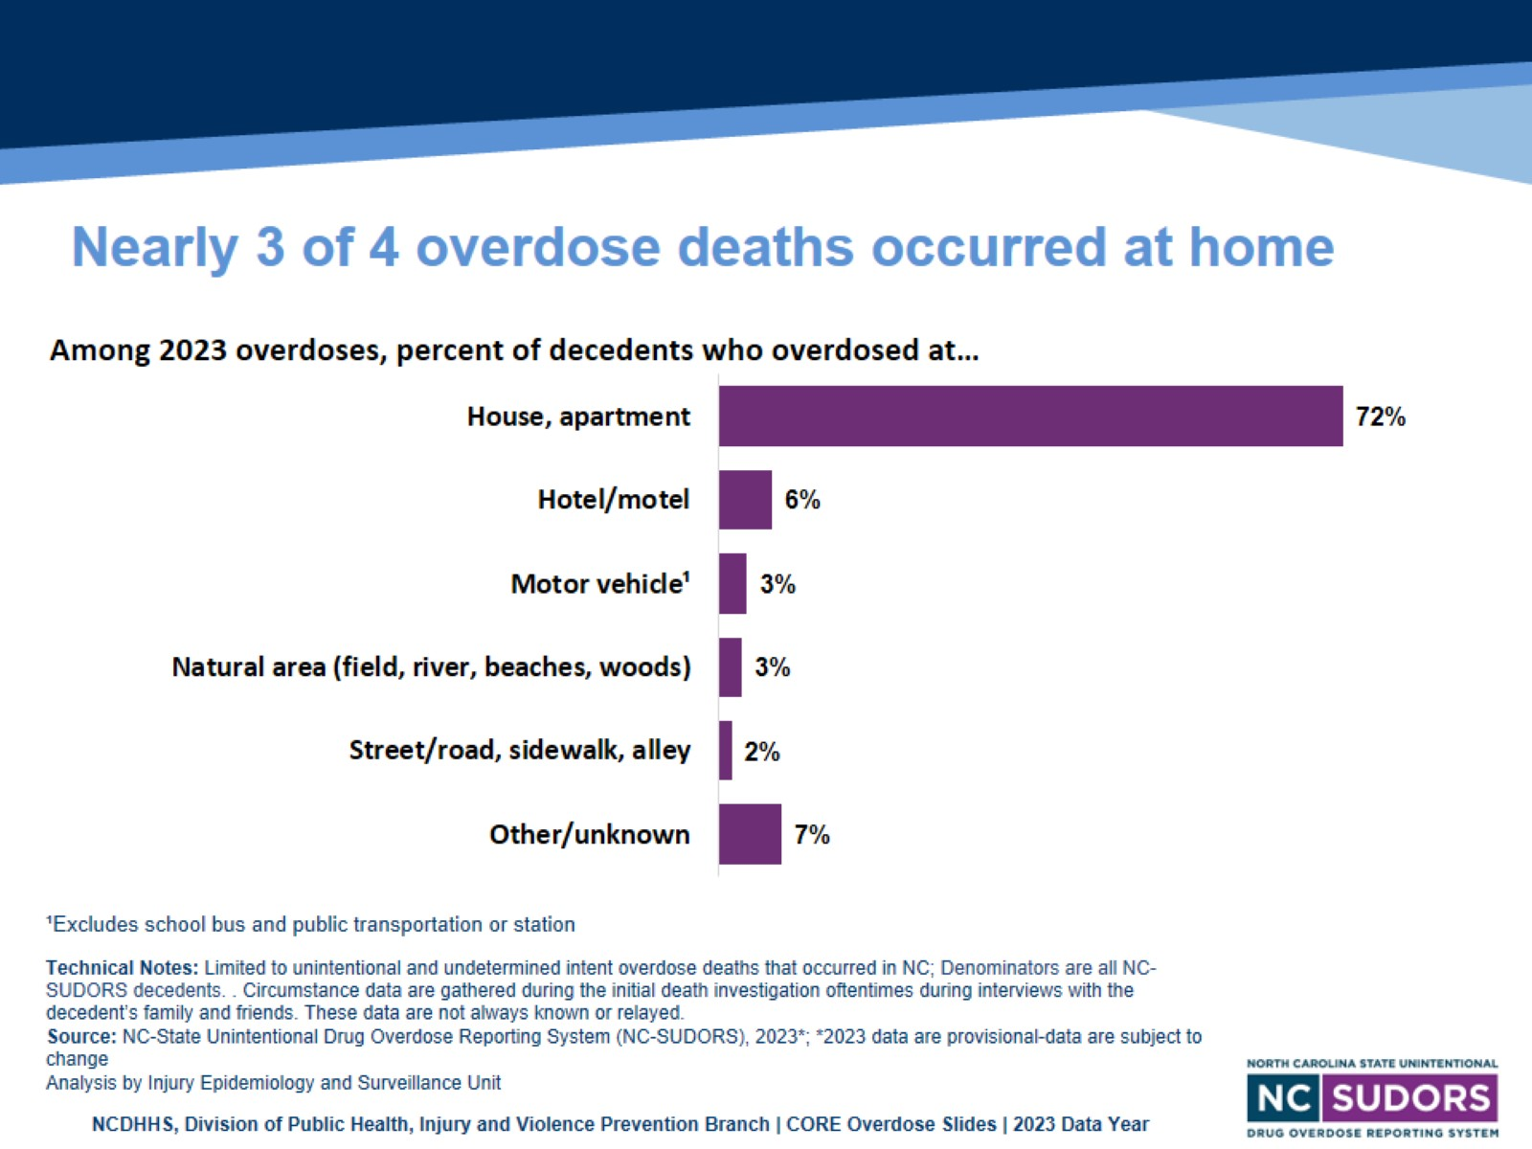
Nearly 3 of 4 overdose deaths occurred at home
Notes:
In 2023, 72% of unintentional and undetermined overdose deaths in North Carolina occurred in a house or apartment.
Other locations included: hotel/motel (6.2%), motor vehicle (3.3%), natural area (2.7%), street/sidewalk/alley (1.5%), and other/unknown (7%).
These data come from the State Unintentional Drug Overdose Reporting System (SUDORS), a program developed by the Centers for Disease Control and Prevention (CDC) as a response to the opioid overdose epidemic to enable states to collect detailed overdose death information. SUDORS provides rich circumstance data and highlights opportunities where intervention could save lives.

Slide 33
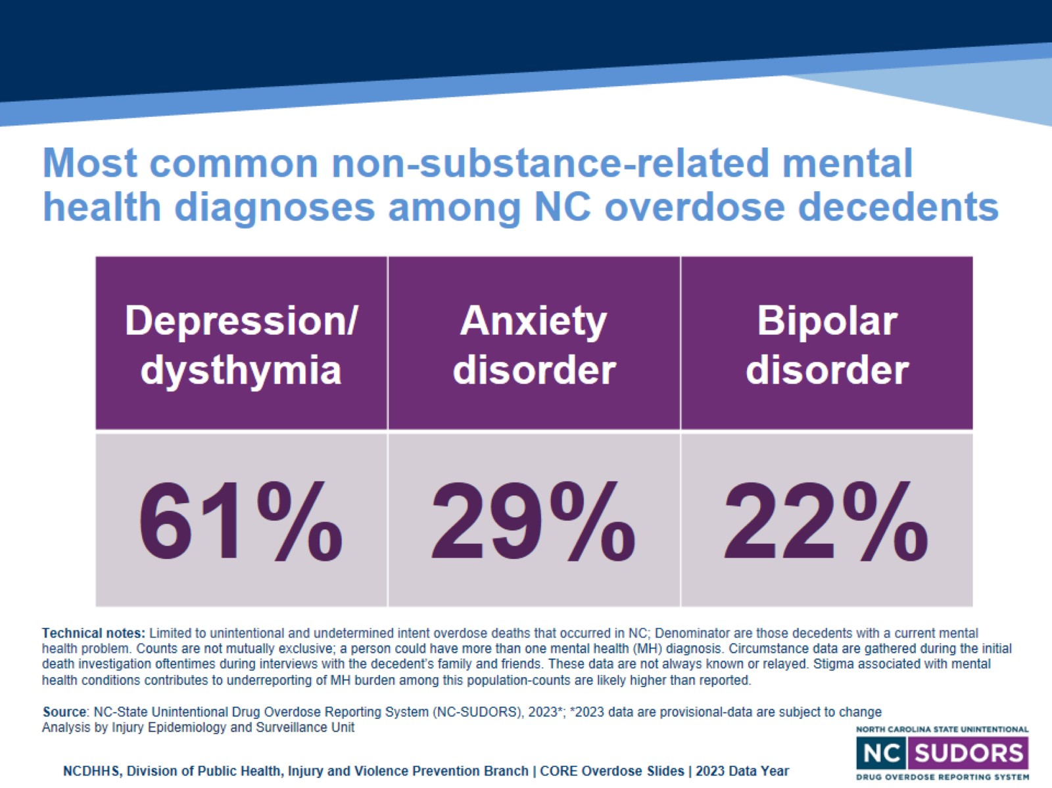
Most common non-substance-related mental health diagnoses among NC overdose decedents
Notes:
The three most common mental health diagnoses from 2019-2023 among North Carolina overdose decedents included depression, anxiety, and bipolar disorder.
After depression (61.0%), anxiety (29.4%), and bipolar disorder (21.9%), the next two most common diagnoses for 2023 were Schizophrenia (14.1%) and PTSD (7.6%).
There are several important caveats to keep in mind:
A single decedent could—and often did—have more than one diagnosis AND
When accounting for undiagnosed and/or undocumented mental health conditions, the true prevalence of at least one mental condition is likely higher than our results show.
These data come from the State Unintentional Drug Overdose Reporting System (SUDORS), a program developed by the Centers for Disease Control and Prevention (CDC) as a response to the opioid overdose epidemic to enable states to collect detailed overdose death information. SUDORS provides rich circumstance data and highlights opportunities where intervention could save lives. Circumstance data are gathered during the initial death investigation oftentimes during interviews with the decedent’s family and friends. All circumstance data are not always known or relayed during the investigation. Stigma associated with mental health conditions contributes to underreporting of MH burden among this population-counts are likely higher than reported.

Slide 34
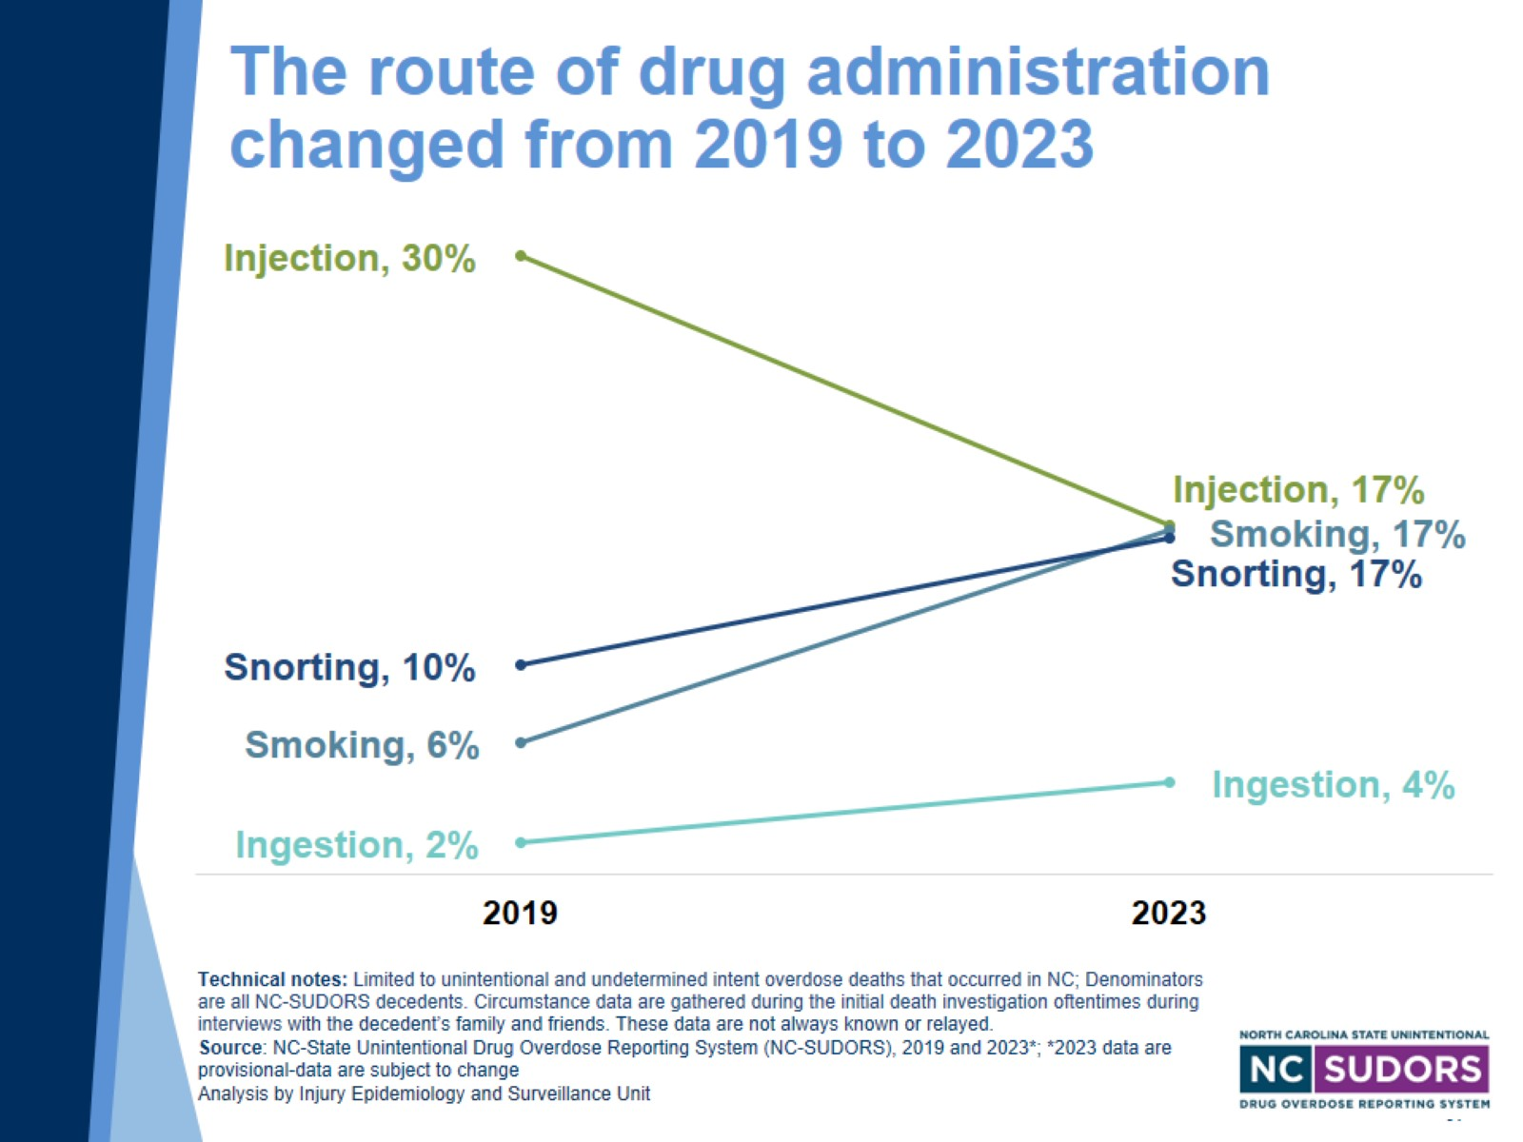
The route of drug administration changed from 2019 to 2023
Notes:
From 2019 to 2023, the percentage of overdose deaths with evidence of injection decreased from 30.3% in 2019 to 17.1% in 2023.
Other routes of administration have increased:
The percentage with evidence of smoking increased from 6.4% to 16.8%
The percentage with evidence of snorting increased from 10.2% to 16.5%
The percentage with evidence of ingestion increased from 1.5% to 4.5%
These data come from the State Unintentional Drug Overdose Reporting System (SUDORS), a program developed by the Centers for Disease Control and Prevention (CDC) as a response to the opioid overdose epidemic to enable states to collect detailed overdose death information. SUDORS provides rich circumstance data and highlights opportunities where intervention could save lives. Circumstance data are gathered during the initial death investigation oftentimes during interviews with the decedent’s family and friends. All circumstance data are not always known or relayed during the investigation.

Slide 35
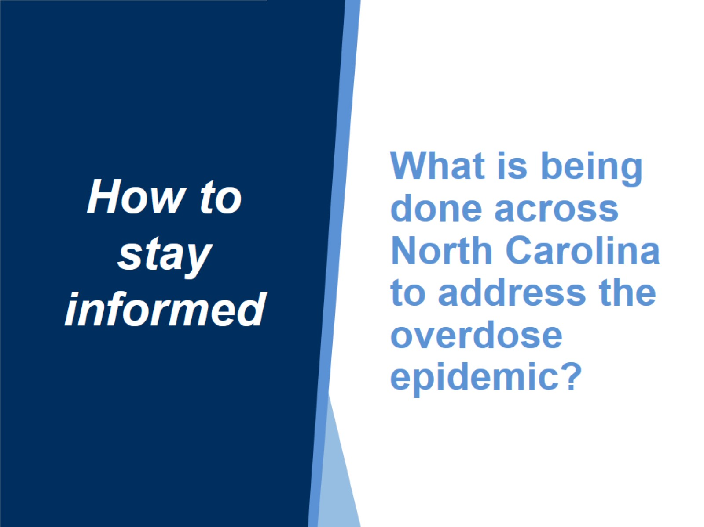
What is being done across North Carolina to address the overdose epidemic?

Slide 36
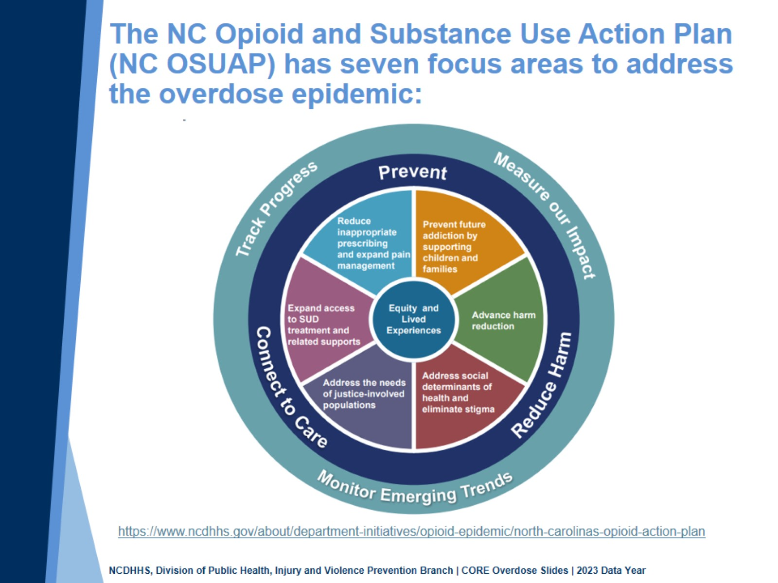
The NC Opioid and Substance Use Action Plan (NC OSUAP) has seven focus areas to address the overdose epidemic:
Notes:
To combat the opioid crisis, the North Carolina Department of Health and Human Services worked with community partners to develop the original North Carolina Opioid Action Plan (NC OAP) in June 2017. Version 2.0 launched in June 2019, and version 3.0 (now the Opioid and Substance Use Action Plan, OSUAP) launched in May 2021.
The NC OSUAP, version 3.0, includes a broadened focus on polysubstance use as well as centering equity and lived experiences to ensure that the strategies address the overdose epidemic are led by those closest to the issue.
The plan focuses on four priority areas to address the epidemic: Center Equity and Lived Experiences, Prevent Future Addiction and Address Trauma, Reduce Harm, and Connect to Care.

Slide 37
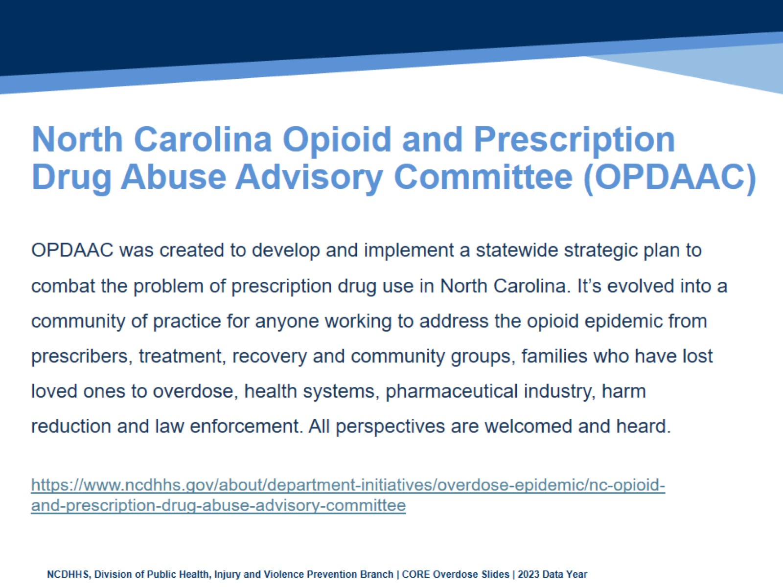
North Carolina Opioid and Prescription Drug Abuse Advisory Committee (OPDAAC)

Slide 38
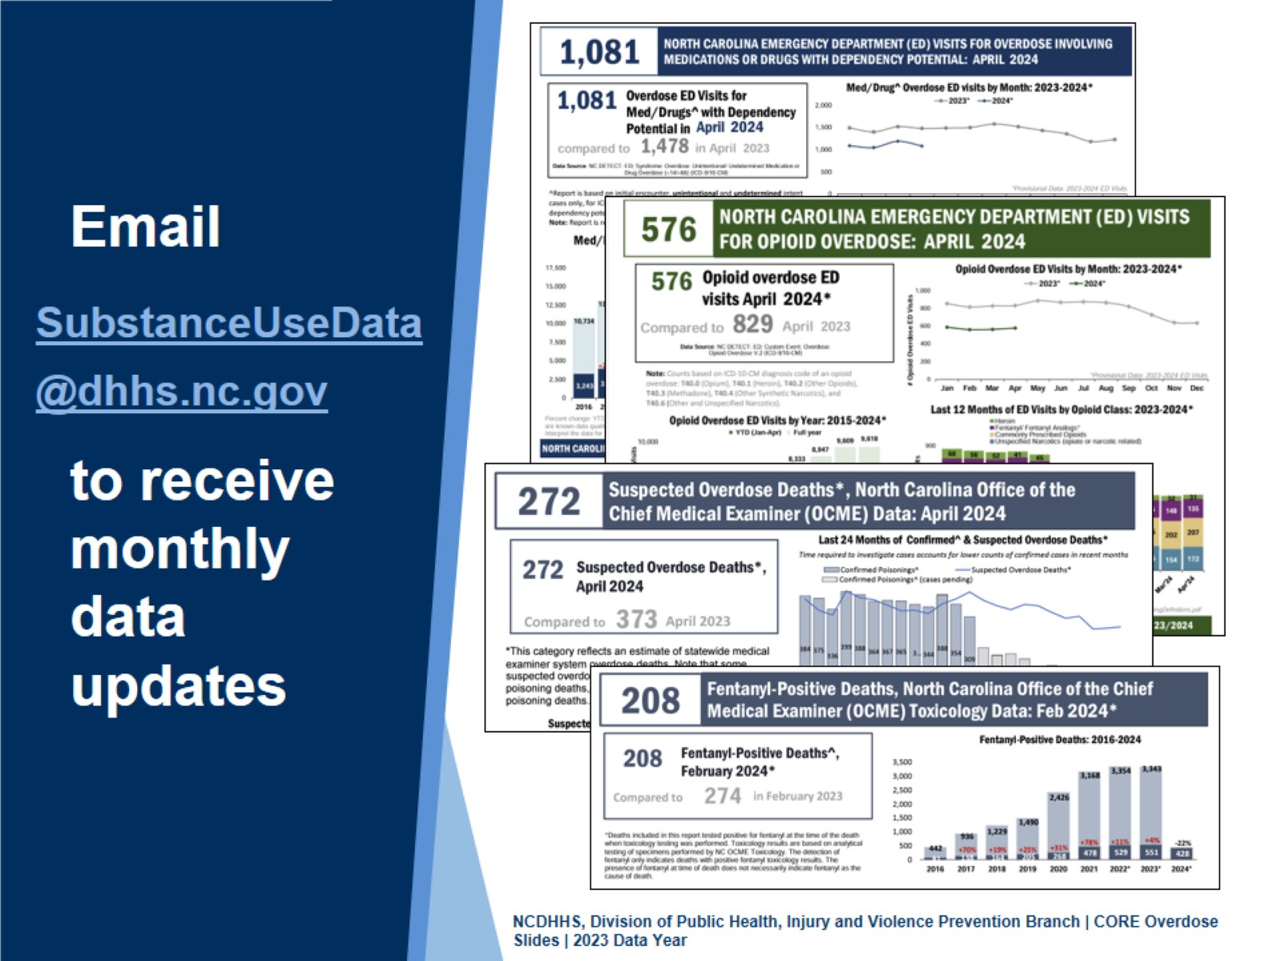
Notes:
Monthly overdose reports including Fentanyl-Positive Deaths, Suspected Overdose Deaths, Med/Drug Overdose ED Visits, and Opioid Overdose ED Visits are available.
Email SubstanceUseData@dhhs.nc.gov to receive monthly updates.
Reports are posted at https://www.dph.ncdhhs.gov/programs/chronic-disease-and-injury/injury-and-violence-prevention-branch/north-carolina-overdose-epidemic-data#monthly-reports

Slide 39
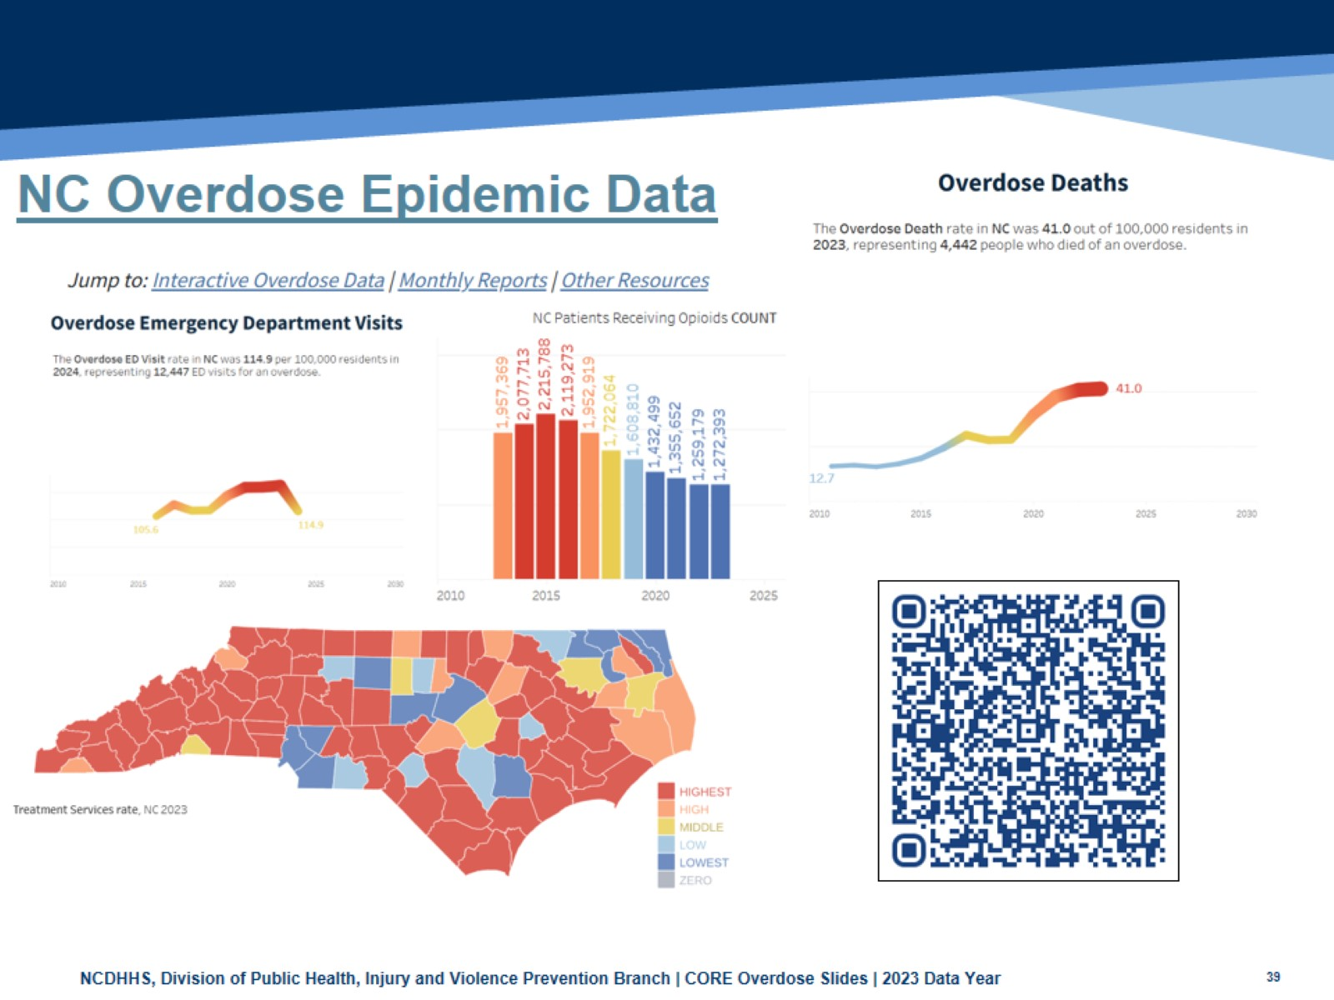
NC Overdose Epidemic Data
Notes:
The new NC Overdose Epidemic Data website launched in December 2024. The page includes monthly overdose surveillance updates, statewide summary data, and interactive visuals of state and county-level indicators. Those indicators include illicit overdose deaths, overdose ED visits, patients receiving buprenorphine or opioids, treatment services, and more.
Visit the dashboard here:
https://www.dph.ncdhhs.gov/programs/chronic-disease-and-injury/injury-and-violence-prevention-branch/north-carolina-overdose-epidemic-data

Slide 40
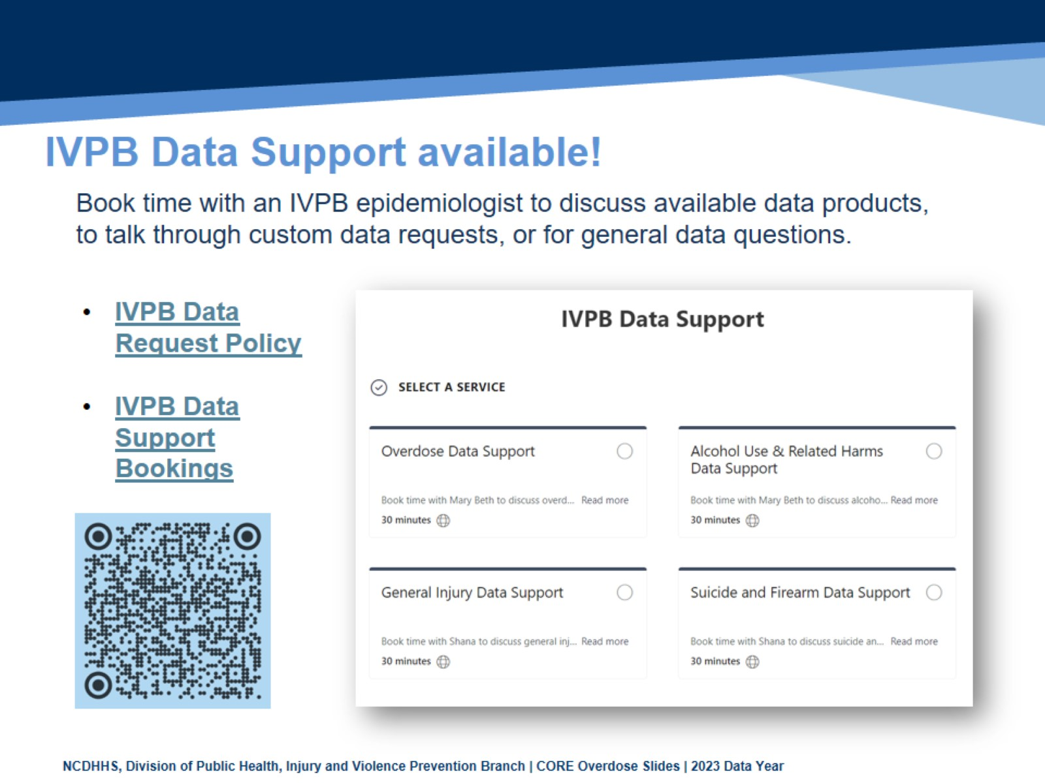
IVPB Data Support available!

Slide 41
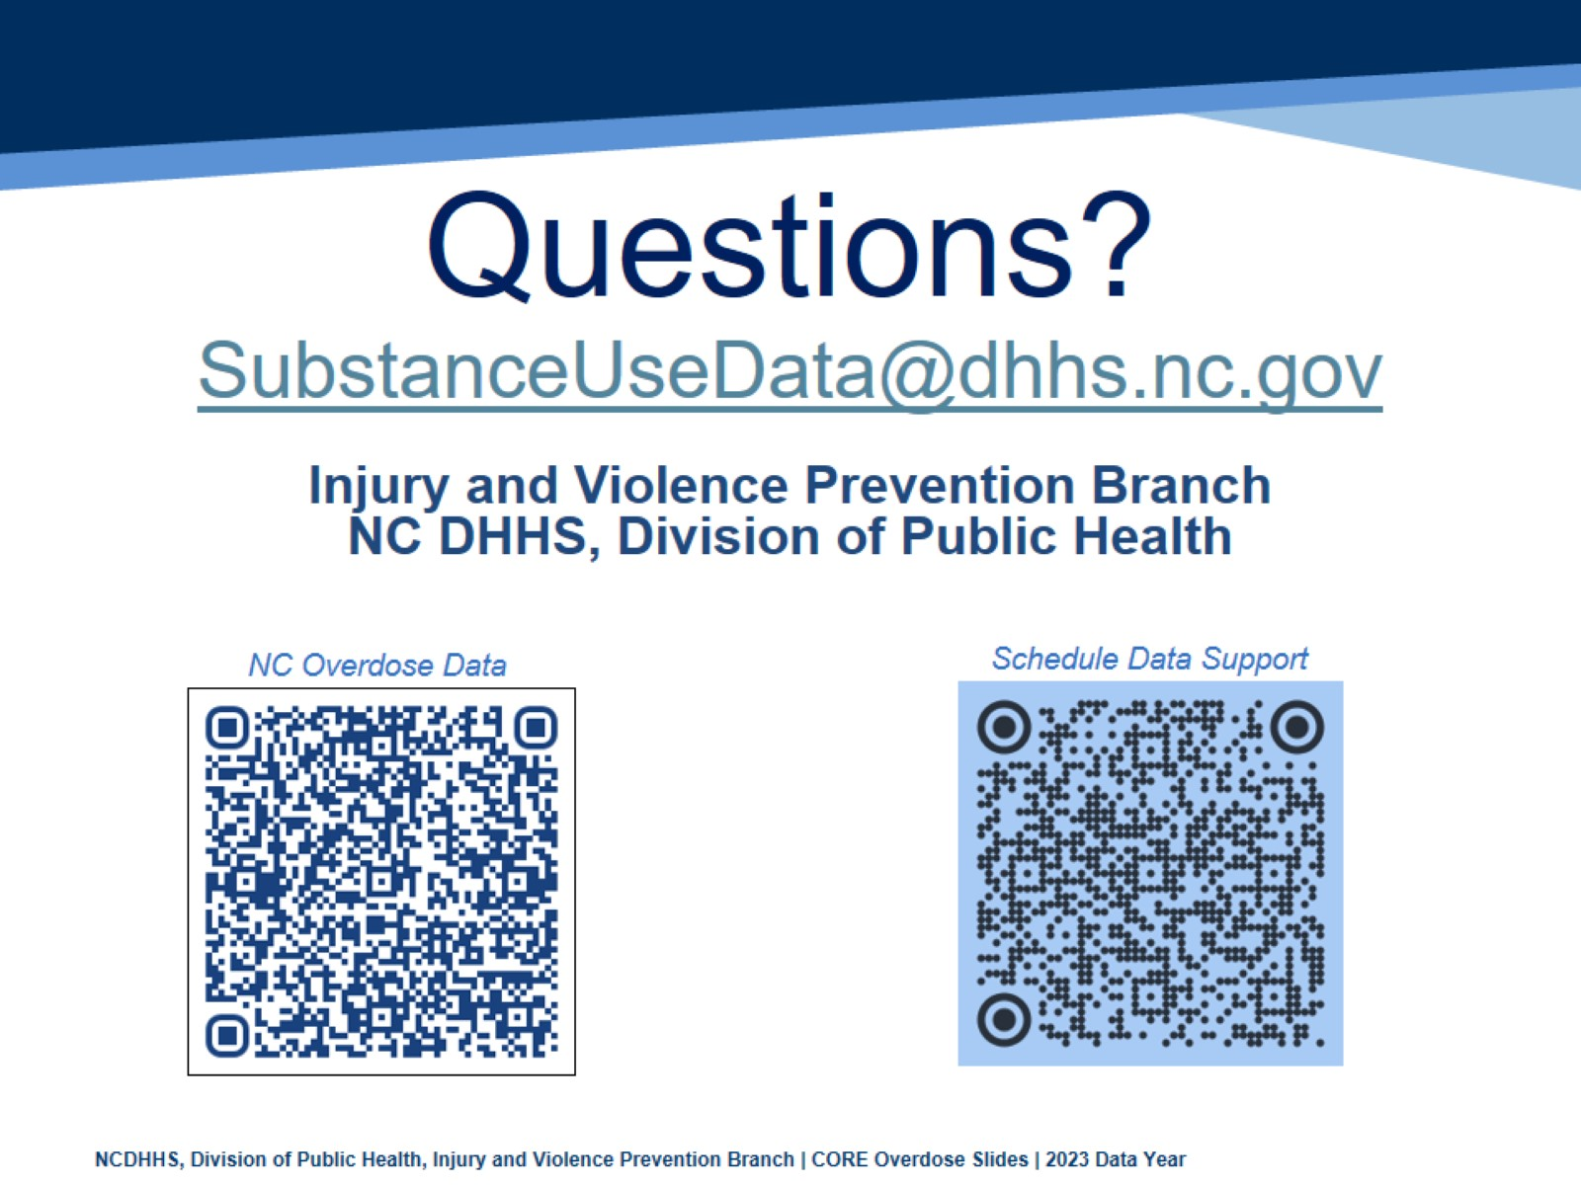
Questions?

